Slide 1
Digital Tools for Verification & Wider Audience Reach

Slide 2
The Digital Age has been described as a ‘golden era for journalism.
It has also delivered unprecedented challenges and structural changes to the news industry.

Slide 3
But….
Journalism is battling a virtual storm from the “fifth estate” of the realm.

Slide 4
Audience expectations of ‘on-demand’ news, mobile delivery and realtime engagement on social media is also increasing pressure on news professionals facing diminishing resources.

Slide 5
The erosion of trust in journalism and mainstream media organisations is causing audiences to dissipate further, diminishing remaining profits and fuelling the spread of ‘information disorder’.

Slide 6
The 2018 Digital News Report by Reuters found only 34% of respondents thought journalists were “trustworthy.”

Slide 7
ARE WE REALLY TRUSTWORTHY?

Slide 8
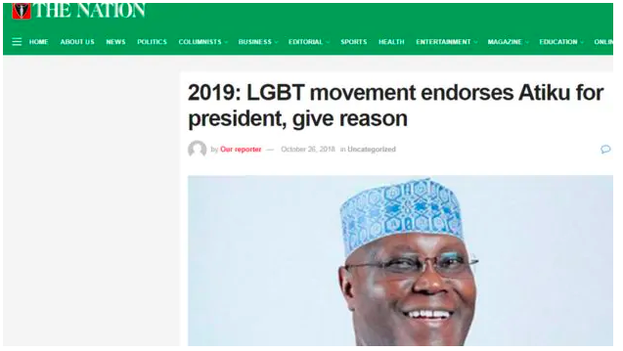

Slide 9
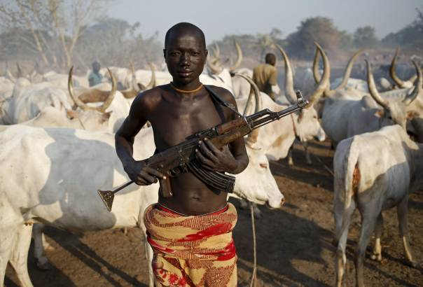
Notes:
Herdsmen attack: How Nigerian newspapers mislead readers with foreign photos
Herdsmen attack: How Nigerian newspapers mislead readers with foreign photos

Slide 10
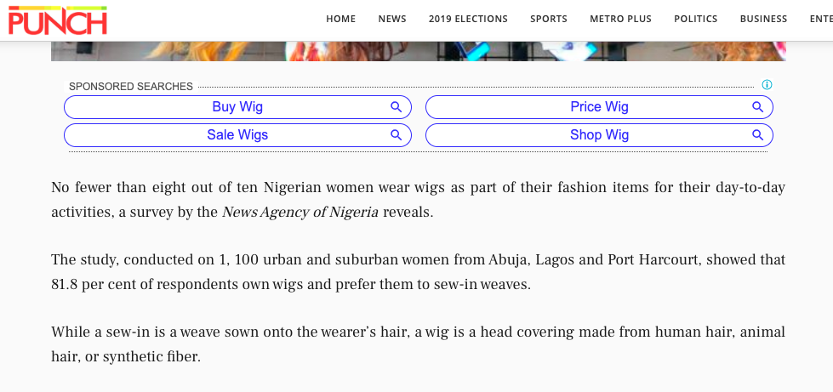
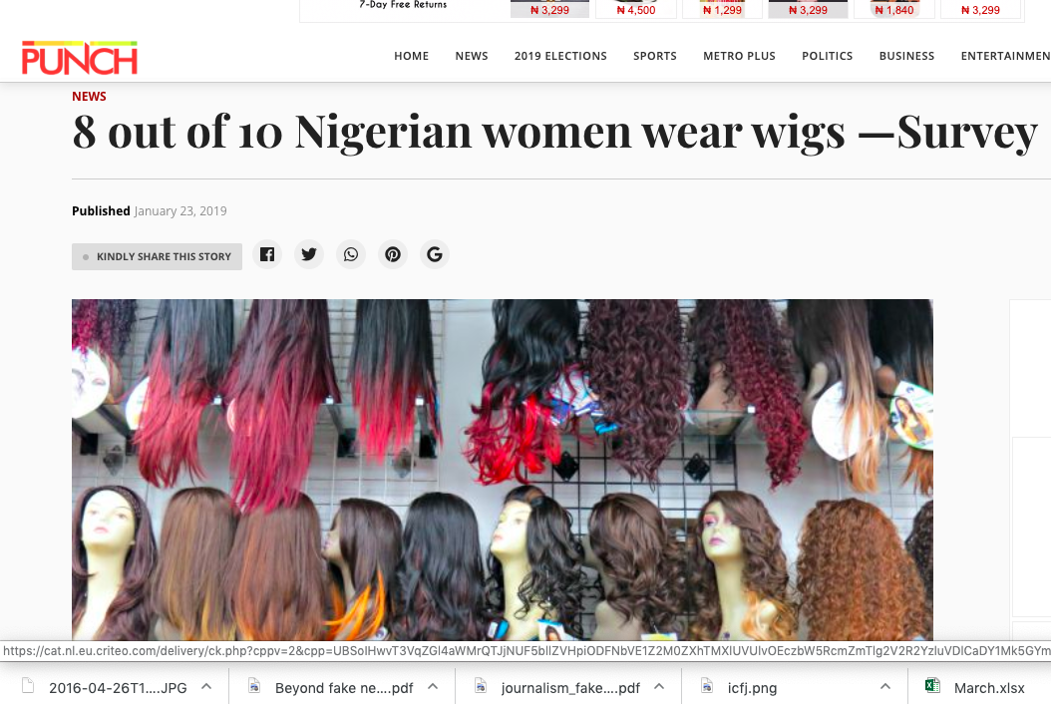

Slide 11
VERIFICATION employs a mix of factors:
A person’s resourcefulness, persistence, skepticism and skill

Slide 12
DIGITAL TOOLS FOR VERIFICATION

Slide 13
TINEYE

Slide 14
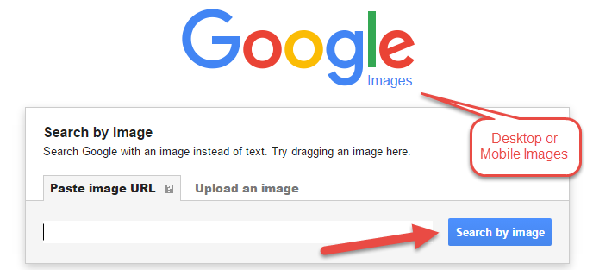
Google Reverse Image Search

Slide 15
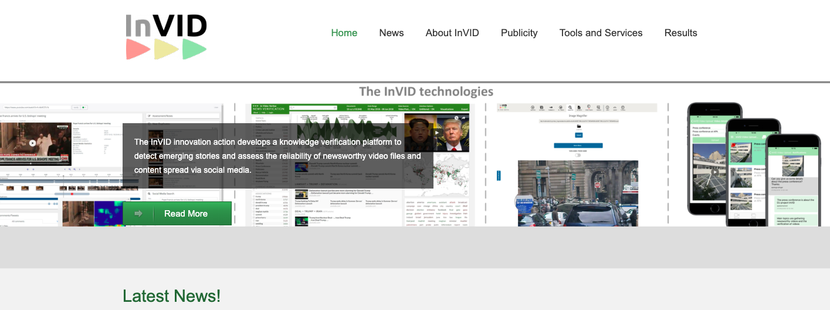
You can also check if a video has been manipulated with inVID

Slide 16
REACHING WIDER AUDIENCES ONLINE ...

Slide 17
WHY FOCUS ON DIGITAL?
Possibility to miss out of loyalty from millennials as a result of heavy reliance on text and traditional methods of sharing both visual and print contents.
Inability to catch up may push audiences to blogs, some of which are full of inaccurate claims, since emphasis is on clicks and not facts.
Millennials are a booming population with strong interest in technology.

Slide 18
WHY FOCUS ON DIGITAL?
As younger millennials continue to make their impact felt in almost every sector, a mobile first approach is crucial for any media firm which seeks to reach this group of image conscious, educated and opinionated individuals.
‘The rise of digital as the central means of acquiring information has effectively transformed news behaviour from a high time spent, low frequency behavioural pattern to a high frequency, low time spent behavioural pattern’-BBC Report.

Slide 19
LUMEN5: CREATIVE STORYTELLING THAT MAKE FACTS GO
VIRAL
Notes:
Lumen5 Link: https://lumen5.com/dashboard/

Slide 20
LUMEN 5: SOCIAL MEDIA VIDEOS MADE EASY
Created as a video platform designed for brands and businesses to produce contents that drives audience engagement online.
Articles can be turned into video in minutes with AI.
Lumen5 render videos in standard 16:9 landscape format, 1:1 square format or 9:16 vertical formats.
The length of each scene is automatically determined based on the amount of text in each segment
Notes:
https://www.facebook.com/AfricaCheckNG/videos/724572074593589/

Slide 21
The Lumen 5 ADVANTAGE
Nigeria has 26 million active Facebook users and about 25 million of them access the platform on their phones.
Using creative video tools like Lumen5 for spreading fact-check reports can help with increased reach and engagement, especially among younger audiences.

Slide 22
Adding Visuals to Stories: Social Media Cards

Slide 25
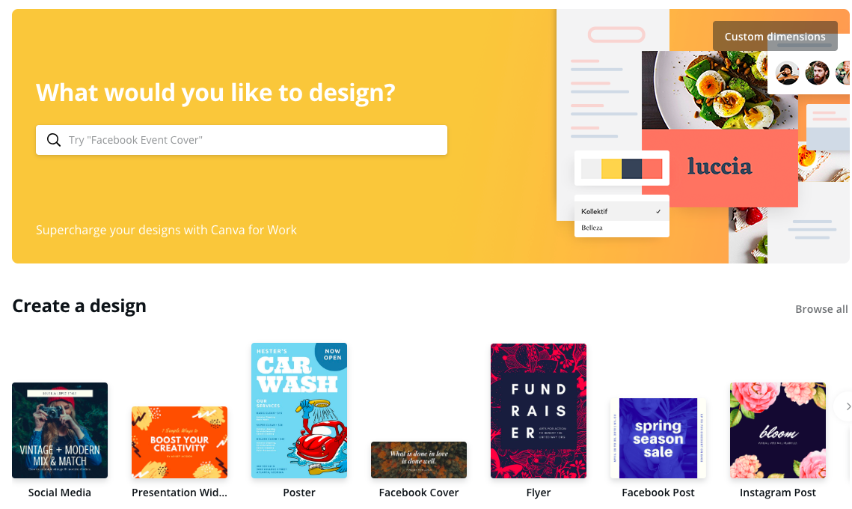
TOOLS YOU CAN USE FOR SOCIAL MEDIA CARDS:
CANVA, PABLO

Slide 26
ADVANTAGES
Increase your social media engagement.
With Canva&Pablo, you can create beautiful images easily to make your posts pop.
Notes:
Pablo: https://pablo.buffer.com/

Slide 27
GIFS: AN EVOLVING STORYTELLING TOOL FOR
DIGITAL JOURNALISTS
GIFs give journalists the tools to illustrate their content in a digestible format, making the story accessible to people who may not have time to read the full article.
GIFS can be used to present visual animations for fact-check stories
Notes:
Giphy: https://giphy.com/gifs/illustration-obama-president-3o6Zthv4W72jUHRCUg
Olympic Video: https://giphy.com/gifs/pri-brazil-pollution-guanabara-bay-xT9DPFjnhSSk5mX48o
Sad Tears Giphy: https://giphy.com/gifs/sad-asian-Hwq45iwTIUBGw

Slide 28
CALL FOR ACTION!
Getting people to read, view or interact with your story is now part of the storytelling process.
You don’t send the paper to print and then go home and go to bed anymore.

