Slide 1
Data Analysis and
Visualisation
Training Manual

Slide 2
Data Appreciation and Analysis
Data as a Value of Communication
Primary data points
Data Engagement model
Data Analysis Tools
Understanding Data (Trend and Predictive Analysis)
Data Sourcing

Slide 3
What is Data?
In class context, we adopt the definition of:
“ (Hidden) factual information (as measurements or statistics) that can be used as basis for reasoning, discussion, or calculation” or
“a collection of facts from which conclusions may be drawn”
Data is not only in numbers, it is a signal to presented in a form that can assessed to make lead a discussion or provide guide decision towards a specific action.
Data is the value for communication and informed decisions. It is the raw material where information can be obtained.
The data could be in the form of numbers, words, pictures, maps, and even newspaper articles.

Slide 4
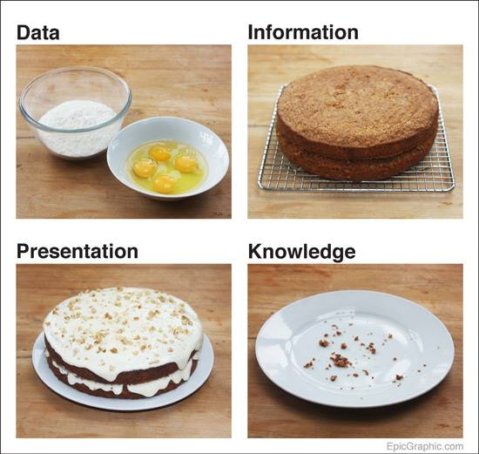
Worksheet – Choose Data, Knowledge, Information & Presentation

Slide 5
The Lifecycle of Data
Discussions
& Decisions
Personalization
The
Knowledge
Presentation
Information
Engagement
Data

Slide 6
Public Finance: Data Points
DMO
Accountant- General
Central Bank of Nigeria
Budget
Office
Accountant- General
International
Research
Platforms
FIRS & Customs
National
Planning
Commission
NNPC

Slide 7
Data Engagement
Analysis
Baseline Analysis
Predictive Analysis
Trend Analysis
Visualisation (Examples)
Charts and Graphs
Object design
Infographics
Interactive Applications

Slide 8
Data Sourcing
Data Sourcing
Primary Data Sources
Secondary Data Sources
Inferred Data Sources
Accessing Data Integrity
The Signal and Noise Scenarios
Validating claim to source
Understanding types of sources
Documents
Observations
Questionnaires
Interviews

Slide 9
Data Analysis Tools
Microsoft Excel
Online Spreadsheets
Fusion Tables
Tableau
Imaginations
Thoughts
Narrative

Slide 10
2.0 Data Lifecycle, Storytelling & Visualisation
Data Collection
Entry
Validation and Improvement
Restructuring the Metrics
Data Publishing and Communication
Feedback Integration
Basic Microsoft Excel Class

Slide 11
Data Mining Process
Collection
Entry
Validation & Improvement
Restructuring the Metrics
Advanced Data Analysis
Data Publishing
Feedback Integration
Understanding the data lifecycle
Identify the challenges.
Tell Process improvement
Look at another angle
Validation Methods & Interlinked Formats
Identify the Core Metrics to simulate
Entry

Slide 12
Data Collection
Identify the primary sources per data
Define Platforms of Data Collections
Web
Direct Mail
Choose bracket of data that needs further validation
Define the Entry Approach
Do we at anytime have certain doubts over data provided by a source organisation which forms a wrong basis
of judgment for non- partisan analysis?

Slide 13
Data Entry
Cleaning Up Approach
Re-entry Approach
Dynamic Generation & Approach
Data Mining and Analytics
Managing Data Overhead from the Sources
Which approach do we prefer? The cleaning up method or data re-entry method? Which is more
better for accuracy purposes?

Slide 14
Data Validation
Access Levels for Validation
Peer review mechanism

Slide 15
Restructuring the Metrics
Choosing the Metrics
Personnel Costs
Capital Expenditure
Revenue
Recurrent Revenue
Sorting

Slide 16
Data Publishing & Effective Communication
Effective Use Graphs & Charts
Object linked representations
Infographics
Interactive Application
Open Formats & APIs
Social Media Usage

Slide 17
3.0 Data Publishing & Effective Communication
Rules of Visualisation
Understanding the Output and Process
The Art of Questioning
Simple online visualisation types
Introduction to Charts, Graphs & Number Use

Slide 18
Conversation & Attention Span
'The true length of a work is its ability to generate an infinite variety of interpretation‘ Ben Okri
The true beauty of a visualisation is in the depth of discussions and varied perspective to the data.

Slide 19
Communication Tools

Slide 20
5 Rules of Visualisation
Find a Story
Define your Audience
Be objective and offer balance.
Be Inclusive in Data Approach
Keep Editing and Improving

Slide 21
The Art of Questioning
Does it provoke human interactions?
Do it make sense and deepens knowledge?
2. Is it a gateway to a more detailed data?
3. A visualization does not mean substituting pictures for words but they serve as interfaces to human interactions that create new opportunities for discussion and action.

Slide 22
STARTING OUT
Source the Data
Define your Audience
Dimension Data
Craft your story
Build/Integrate with Platform
Develop a Feedback System

Slide 23
DIMENSION DATA
Spreadsheets
Fusion Tables
Graphs
Tableau
DataWrapper
Map Tools

Slide 24
CRAFT YOUR STORY
Find Insight
Lead not Control the Narrative
Predictive Analysis
Trend Analysis
Peer Comparison

Slide 25
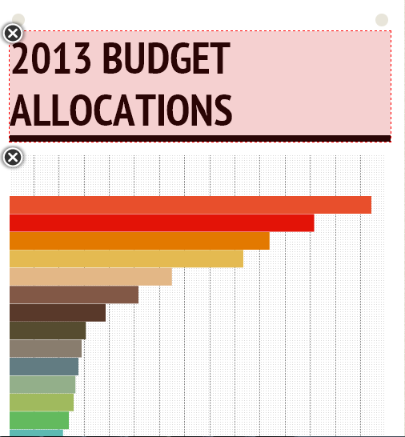
infogr.am

Slide 26
The Picture & the Data

Slide 27
Bar Chart : Trends and Item Comparison
Source: INEC, BudgIT Research
Xxxxxx

Slide 28
Line Graphs: The relationship between two types of information
Source: Federal Ministry of Finance
After the exit of Nigeria from the Paris Club, amount used in servicing Nigeria’s external debt dropped . However, domestic debt service has risen with the appetite of Nigerian government for domestic bonds and treasury bills.

Slide 29
Pie Chart: Compare Parts of the whole.
Nigeria Uncompleted Projects
Source: Federal Ministry of Finance
Xxxxxx

Slide 30
4.0 Data Publishing and Communication
Effective Use Graphs & Charts
Object linked representations
Simple Infographics Samples using Microsoft PowerPoint
Course Evaluation

Slide 31
The White Space Phenomenon
Further on Capital Expenditure : Large Number of Uncompleted Projects estimated at N8.4 Trillion. Unpaid liabilities of MDAs to contractors in 2010 alone are over N200bn.
NO. OF
AMOUNT (N'bn)
TOTAL
S/N
MDAs
PROJECTS
2011 Budget
Projection
(2012 - 2014)
2012
2013
2014
1
FCTA
†
42
44.63
401.24
306.14
191.22
898.60
2
NIGER DELTA
†
124
51.98
856.70
670.76
409.90
1,937.35
3
AVIATION
98
28.71
91.21
18.02
78.99
188.23
4
DEFENCE
203
38.25
110.02
59.45
19.85
189.32
5
EDUCATION
1,374
51.83
55.37
40.38
30.10
125.85
6
HEALTH
968
55.41
161.64
123.55
118.02
403.21
7
INTERIOR
127
6.78
16.37
15.51
14.88
46.77
8
POLICE
120
10.06
62.28
60.86
58.24
181.37
9
POWER
532
87.25
78.66
149.58
37.19
265.43
10
TRANSPORT
46
53.98
99.87
29.92
16.13
145.92
11
WATER
659
62.05
250.17
149.87
630.01
1,030.05
12
WORKS
400
155.39
297.68
281.77
128.32
707.77
13
AGRICULTURE
270
31.40
31.54
100.69
103.79
236.03
Total: 13 Big Spending MDAs
4,963
678
2,513
2,007
1,837
6,356
17 Other MDAs
1,331
249
174
373
93
641
Total
6,294
927
2,687
2,380
1,930
6,997
† Projects include critical new projects.

Slide 32
3D Charts
Source: INEC, BudgIT Research
Xxxxxx

Slide 33
Infographics
1. “A picture worth more than a thousand words”. Using simple graphics to communicate complex amount of information or data
2. Creating an effective infographic requires
A clear conceptualization of the message or story that the graphic is intended to convey
A method for translating that concept into a ﬁnished product.

Slide 34
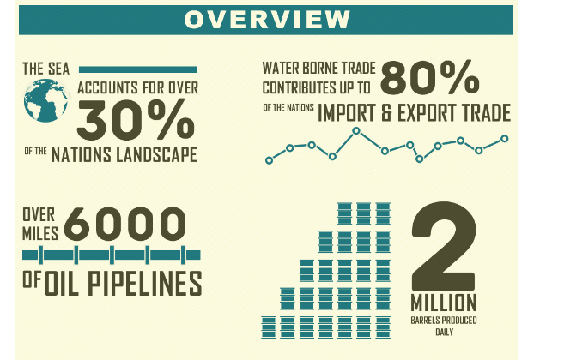
Object-linked Representation
Source: Nigerian Navy

Slide 35
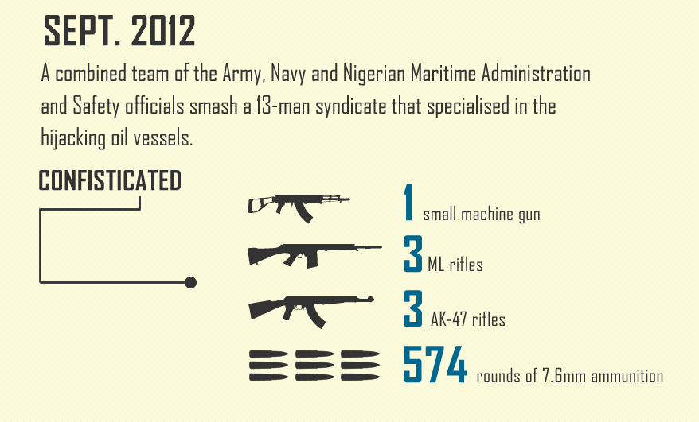
Object-linked Representation
Source: Nigerian Navy

Slide 36
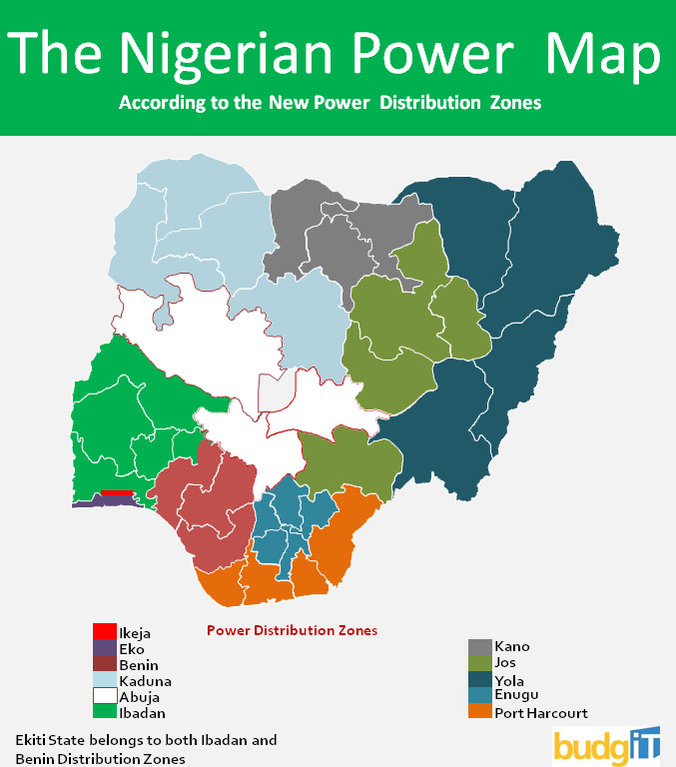
Maps
Data now better visualized,
What do you see?
Using Maps effectively for data
Representation.

Slide 37
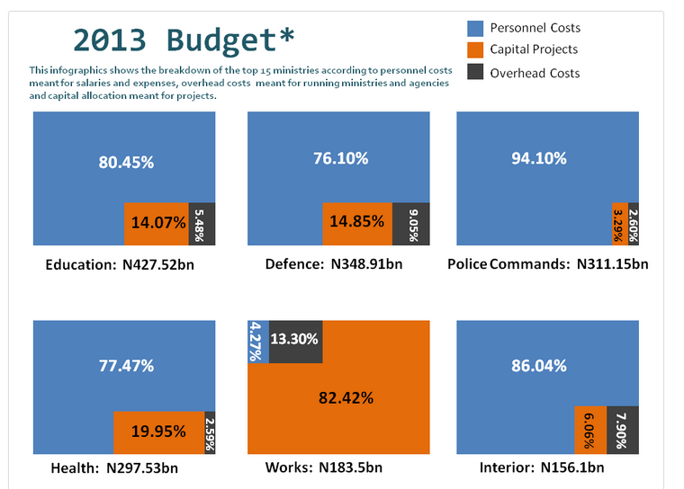
Infographics using Objects

Slide 38
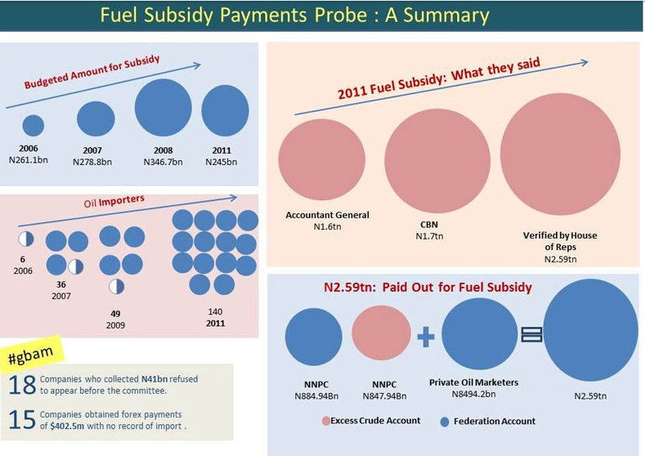
Infographics using Objects

Slide 39
Notes
Dimension Objects with values
Use Colors Appropriately
Use Text Appropriately with Bold numbers
Work with Sequence
Clarity of Message and Story

Slide 40
Microsoft PowerPoint
Developing Simple Charts and Visualisations

Slide 41
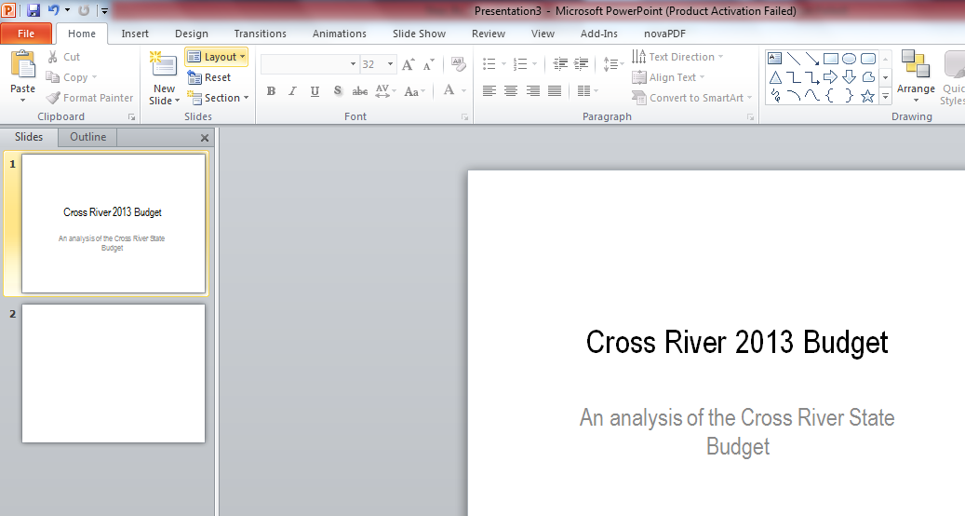
Opening a PowerPoint Page
To start using Powerpoint, there are boxes to put your title and subtitle as shown above.
Hold Control and M to add more slides at the left hand corner.

Slide 42
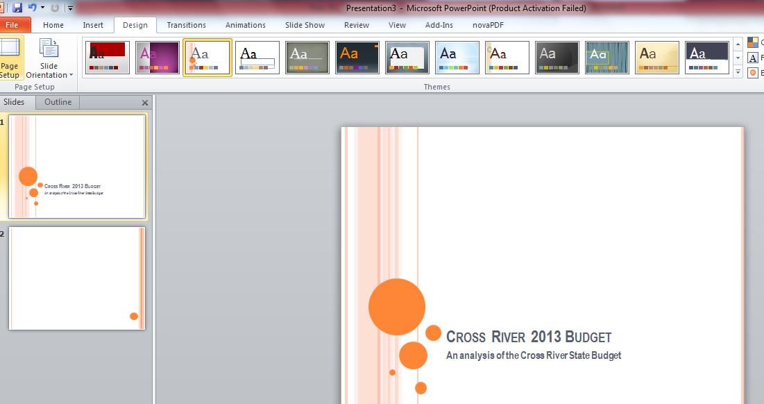
Putting up a PowerPoint Background
Click on Design on the top corner of the PowerPoint slide and choose which design will be most effective.

Slide 43
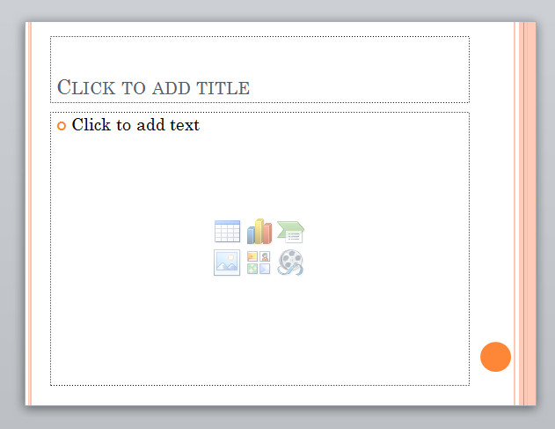
Opening the Chart
Click on the chart tool on the Microsoft PowerPoint page and it opens a new Excel sheet.

Slide 44
Opening a PowerPoint Page
Type in the relevant content into the space

Slide 45
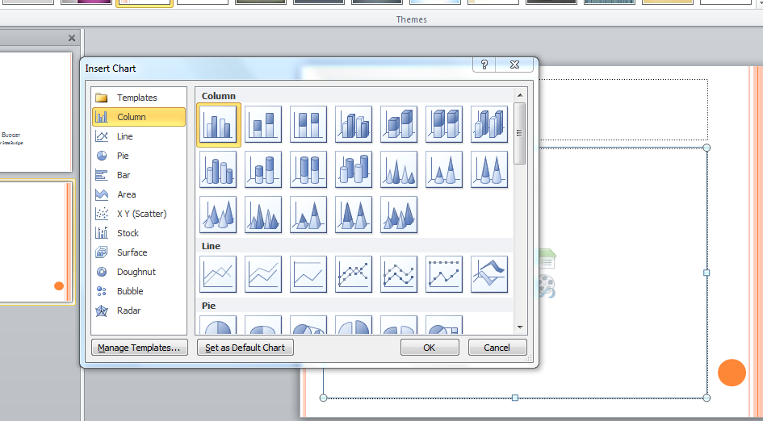
Choosing an Array of Charts
Click on the appropriate chart tool on the Microsoft PowerPoint.

Slide 46
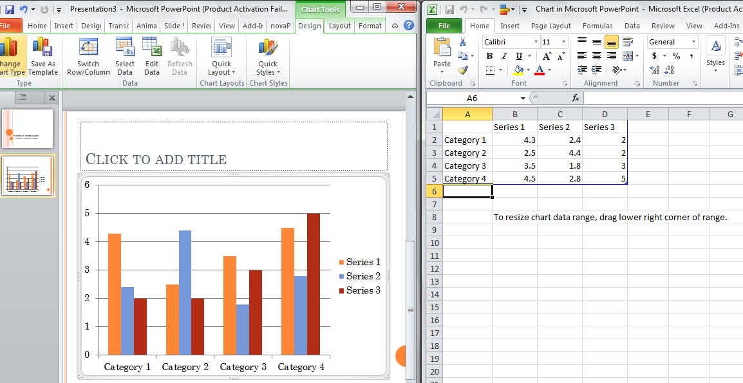
Opening the Chart
Edit the Excel Sheet appropriately and add the content to be visualized.
After completion, close the Excel Sheet.

Slide 47
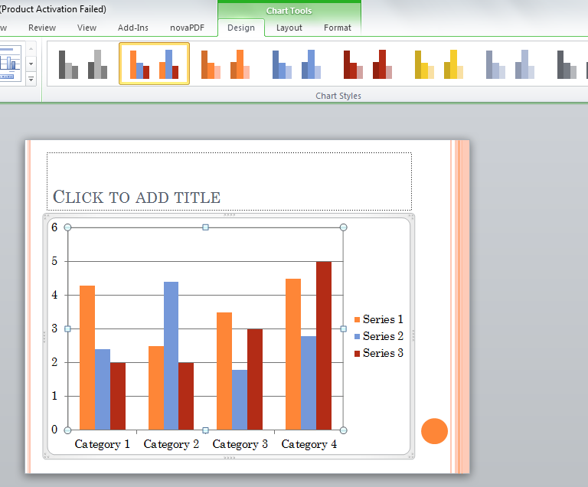
Coloring the Chart
1. Click on the chart to activate the chart options.
2. Colour the charts by clicking on the array of icons on top.

Slide 48
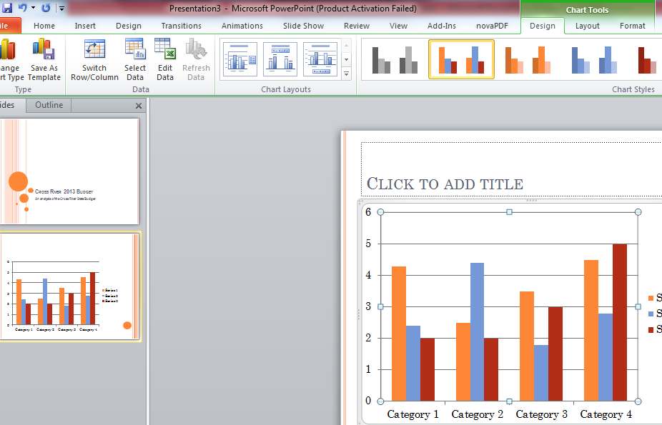
Formatting the Chart
1. Choose the array of options highlighted to improve your charting options.
.

Slide 49
Formatting Charts in PowerPoint
1. Choose the array of options highlighted to improve your charting options.
.

Slide 50
Bar Chart : Trends and Item Comparison
Samples
Source: INEC, BudgIT Research
Xxxxxx

Slide 51
Line Graphs: The relationship between two types of information
Samples
Source: Federal Ministry of Finance
After the exit of Nigeria from the Paris Club, amount used in servicing Nigeria’s external debt dropped . However, domestic debt service has risen with the appetite of Nigerian government for domestic bonds and treasury bills.

Slide 52
Pie Chart: Compare Parts of the whole.
Samples
Nigeria Uncompleted Projects
Source: Federal Ministry of Finance
Xxxxxx

Slide 53
Starting with Text boxes
1. Use the blank layout to start the text boxes.
.

Slide 54
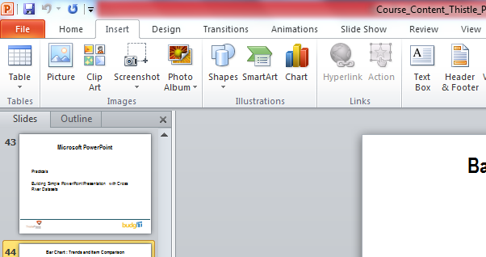
Using Text Boxes
Click on the insert option and choose the Text box.
Immediately type in a the required words such as words or numbers.

Slide 55
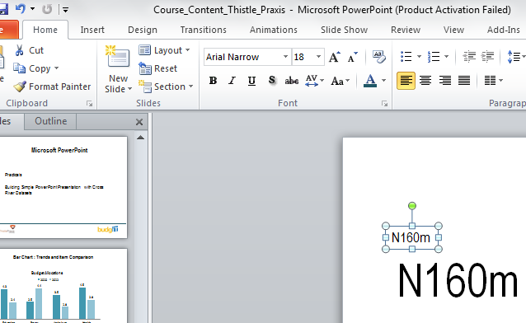
Effectively Using Text boxes
1. After choosing the text box by clicking on Insert, edit the content effectively by using the icon at the top.

Slide 56
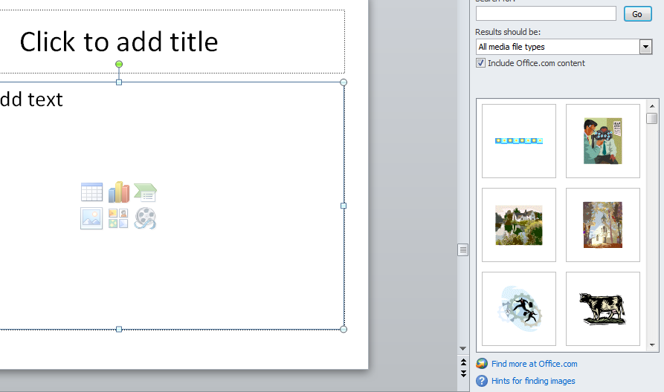
Clip Art Inclusion
Use clip art effectively by clicking on it.
Click on “Go” and choosing the effective icon that matches the right story.

Slide 57
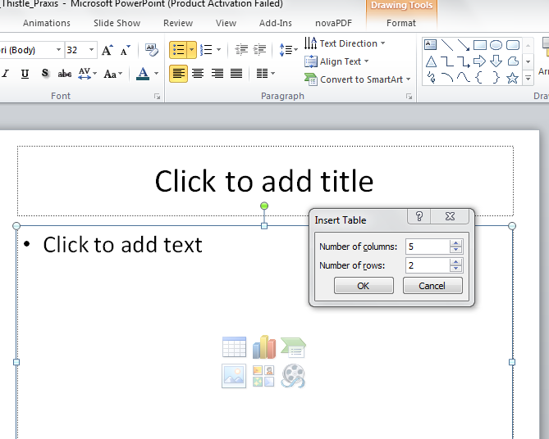
Creating Tables
Click on the Table icon on the page.
Choose the number of rows and columns as required.

Slide 58
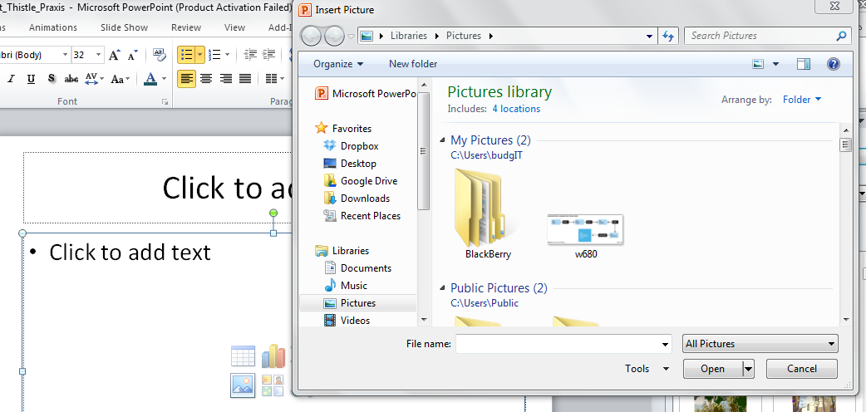
Importing Pictures
Click on the Pictures icon on the page.
Go to the required source document and import the appropriate document.

Slide 59
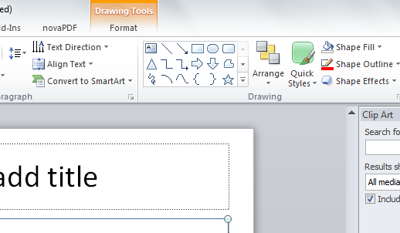
Using Shapes Effectively
To use shapes to make designs, choose the appropriate shape
Use the Shape Fill and Outline to appropriately colour.

Slide 60
Samples
Infographics Example
Source: Nigerian Navy

Slide 61
Samples
Infographics using Shapes & Objects

Slide 62
Infographics Notes
Dimension Objects with values
Use Colors Appropriately
Use Text Appropriately with Bold numbers
Work with Sequence
Clarity of Message and Story

Slide 63
Infogr.am & DataWrapper
Developing Simple Charts and Visualisations

Slide 64
DataWrapper – datawrapper.de

Slide 65
DataWrapper
Prepare your document in Excel Sheet and save in a CSV format.

Slide 66
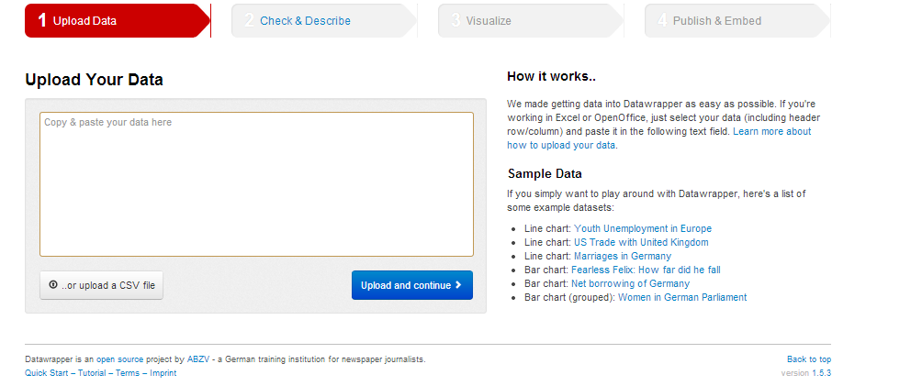
DataWrapper (datawrapper.de)
Login to the website (datawrapper.de).
Upload the Document in CSV format

Slide 67
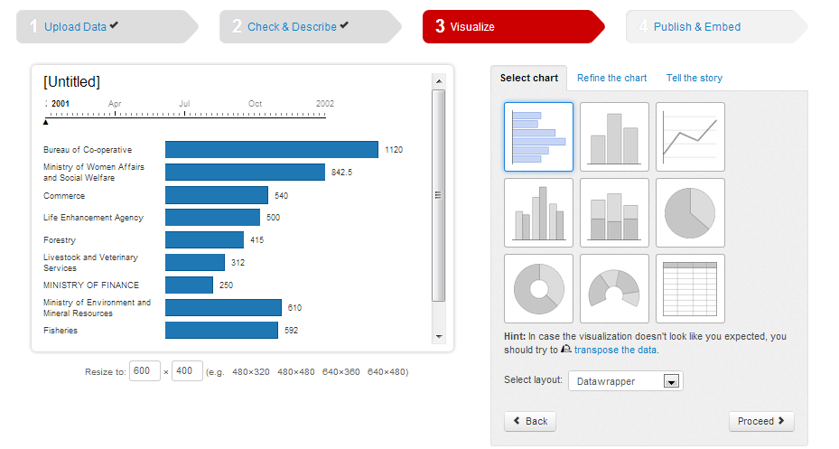
DataWrapper
Open the website (datawrapper.de).
Upload the Document CSV format

Slide 68
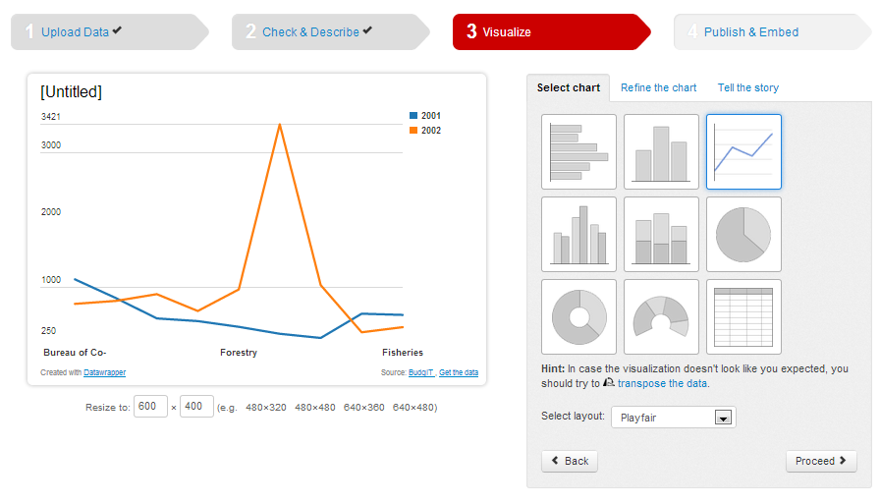
Visualizing on DataWrapper
Follow the prompts and choose the appropriate chart
Publish the chart as picture or embed into the website.

Slide 69
Infogr.am Login (infogr.am)
Login into infogr.am website using a social link

Slide 70
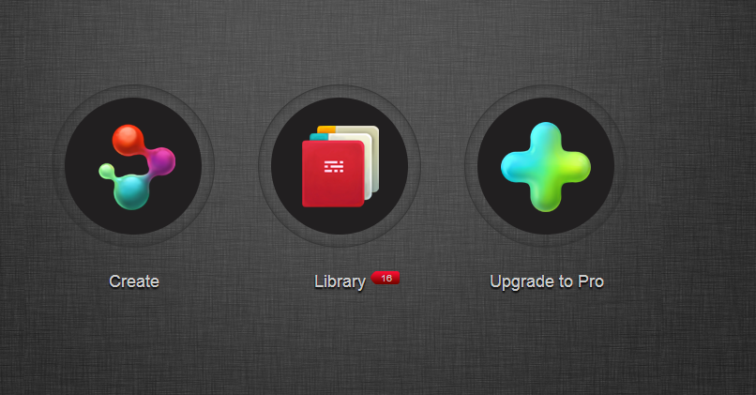
Begin Infographic (infogr.am)
Start by using the create icon

Slide 71
Choose Infogr.am Template (infogr.am)

Slide 72
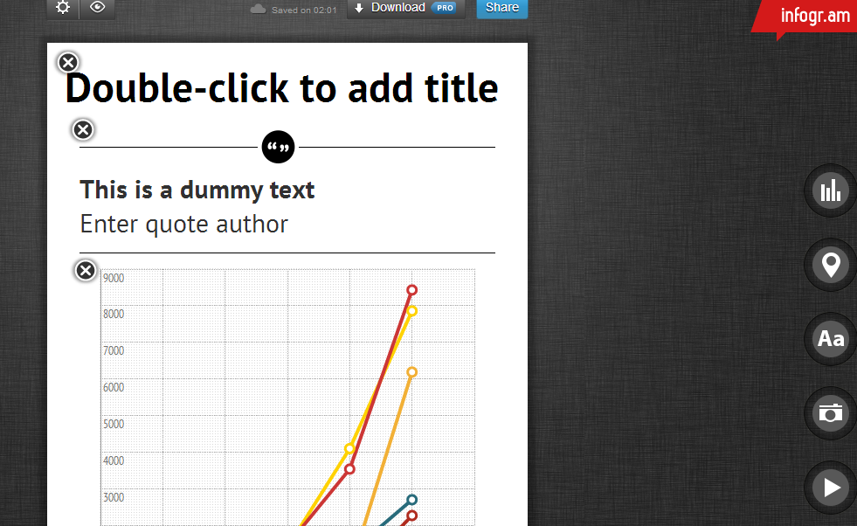
Use tools Infogr.am Template (infogr.am)

Slide 73
Use tools Infogr.am Template (infogr.am)

Slide 74
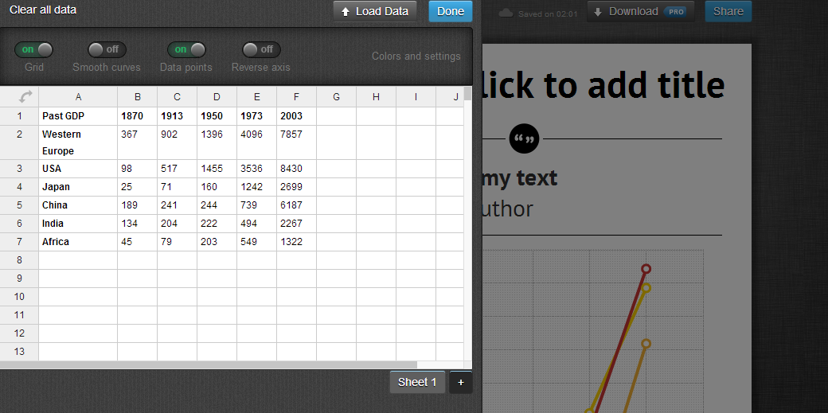
Use Chart tools on Infogram

Slide 75
yourbudgit.com
@budgitng
facebook.com/budgitng
info@yourbudgit.com

