Slide 1
EDITORIAL CONFERENCE on Legal and Ethical Issues in Investigative Journalism in Nigeria organized by The Media Trust Limited and Centre for Media Law and Development at Rockview Royale, Adetokunbo Ademola Crescent, Wuse, Abuja 9 APRIL, 2019

Slide 2
THEME Legal and Ethical Issues in Investigative Journalism in Nigeria

Slide 3
SECURITY AGENCIES AND THE MEDIA IN NIGERIA: AN OVERVIEW
Presented at The Media Trust Limited on 9 April 2019
By
Air Commodore Yusuf Anas (Rtd) B.Sc, M.Sc, fwc, MNIPR, MIPRA, MNIM
Executive Secretary
Centre for Crisis Communication (CCC)

Slide 4
TOPIC Security Agencies and the Media in Nigeria: An Overview

Slide 5
INTRODUCTION

Slide 6
INTRODUCTION
The relationship between the security agencies and the media:
Very critical in safeguarding and shaping of the democratic credentials of any nation
Both groups are significantly imbued with patriotic ideals and are indispensable elements in the progressive running of societies

Slide 7
INTRODUCTION (Cont)
Security agencies and the media play different roles
See things from different perspectives in matters of national interest, security, peace and progress
They understand, promote, protect and appreciate one another as co-stakeholders in the task of nation building

Slide 8
INTRODUCTION (Cont)
Strategic importance of security agencies and the media to any nation, sometimes appear to hold contrary views on what constitutes national interest and security.

Slide 9
INTRODUCTION (Cont)
Strategic importance
The security agencies owing to the sensitive nature of their duties, which include regime protection and defence of the nation, consider secretiveness and confidentiality not as a ‘shortcoming’ but as an important strategic attribute
The media, acclaimed ‘watchdog of the society’, believes that the public ought to know everything and indeed expect the security agencies to be made accountable on what they are doing

Slide 10
INTRODUCTION (Cont)
Hence, it is imperative to seek ways that will enhance collaboration between both sides as they carry out their statutory responsibilities.

Slide 11
INTRODUCTION (Cont)
The priority of any government is to ensure the security of lives and properties of its citizens
The security agencies in contemporary times have been called upon to tackle the threats of terrorism, militancy, kidnappings, farmers-herders clashes, communal and religious violence
The security agencies are collectively engaged in the essential tasks required for meeting the internal security objectives of ensuring safety and security of Nigeria’s territory, its population and all critical infrastructure

Slide 12
INTRODUCTION (Cont)
The media has remained a crucial pillar in the assessment of security agencies and the society at large
The need for security continues to be imperative in our democratic space, there will always be the need not only to communicate with people outside the security services but to put them in check

Slide 13
INTRODUCTION (Cont)
The pertinent questions to ask therefore are:
What constitutes National Interest and who defines it?
What are the key factors affecting national interest and what are the linkage areas between the security agencies and the media?
How far and to what extent does the interaction affect the conduct of both parties?
What necessary considerations can the media accord the security agencies involved in their daily operations based on the common understanding of what constitutes national interest?

Slide 14
AIM
To give a brief overview of the complex relationship between security agencies and the media with a view to eliciting discussion towards enhancing national security in Nigeria.

Slide 15
SCOPE
Conceptual Clarifications.
Overview of Security Agencies and the Media in Nigeria.
The Relationship between Security Agencies and the Media in Nigeria in the Context of National Security.
Challenges of the Relationship between the Security Agencies and the Media in Nigeria.
The Way Forward.

Slide 16
CONCEPTUAL CLARIFICATIONS

Slide 17
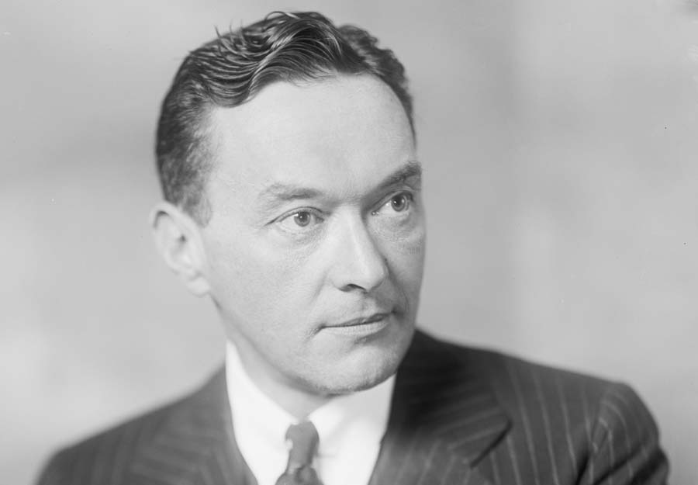
CONCEPTUAL CLARIFICATIONS
Security Agencies:
"A nation has security when it does not have to sacrifice its legitimate interests to avoid war, and is able, if challenged, to maintain them by war.“
(Walter Lippmann, an American writer, journalist and a political commentator, 1887-1974).
Walter Lippmann

Slide 18
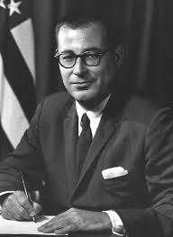
CONCEPTUAL CLARIFICATIONS (Cont)
Security Agencies:
"National security is the ability to preserve the nation's physical integrity and territory; to maintain its economic relations with the rest of the world on reasonable terms; to preserve its nature, institution and governance from disruption and to control its borders."
(Harold Brown, U.S. Secretary of Defense, 1977-1981).
Harold Brown

Slide 19
CONCEPTUAL CLARIFICATIONS (Cont)
The Media:
The media is the communication channel through which news, entertainment, data or promotional messages are disseminated.
- Dictionary.Com

Slide 20
OVERVIEW OF SECURITY AGENCIES AND THE MEDIA IN NIGERIA

Slide 21
OVERVIEW OF SECURITY AGENCIES AND THE MEDIA IN NIGERIA
Nigeria, like other nation states, created a number of security agencies constitutionally empowered and mandated to ensure the maintenance of law and order, protection of lives and properties and the defence of the territorial integrity and sovereignty of the country
There are a number of institutions and agencies in Nigeria, each charged with specific or complementary duties and responsibilities as stipulated and defined by the acts that set them up

Slide 22
OVERVIEW OF SECURITY AGENCIES AND THE MEDIA IN NIGERIA (Cont)
Purpose of this paper:
We shall focus specifically on the military, police, para-military and intelligence agencies

Slide 23
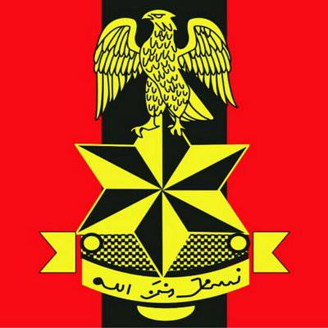
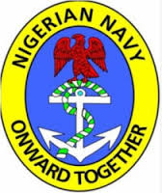
OVERVIEW OF SECURITY AGENCIES AND THE MEDIA IN NIGERIA (Cont)
Security Agencies:
The military known as the Armed Forces of Nigeria consists of the Nigerian Army, the Nigerian Navy and the Nigerian Air Force

Slide 24
OVERVIEW OF SECURITY AGENCIES AND THE MEDIA IN NIGERIA (Cont)
Security Agencies:
The Nigeria Police Force is the lead agency among the para-military institutions in Nigeria

Slide 25
OVERVIEW OF SECURITY AGENCIES AND THE MEDIA IN NIGERIA (Cont)
Security Agencies:
Other para-military agencies includes the Nigeria Security and Civil Defence Corps, the Nigerian Prisons Service and the Nigeria Immigration Service

Slide 26
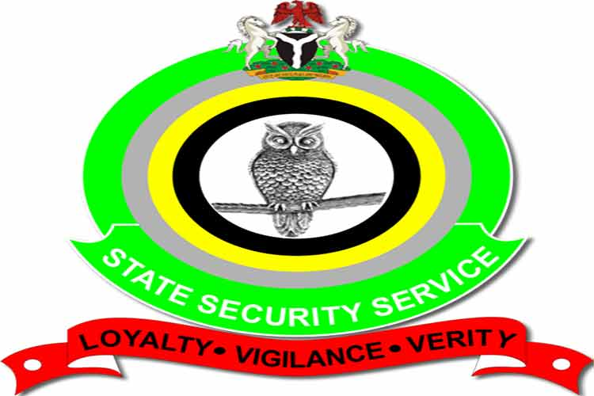
OVERVIEW OF SECURITY AGENCIES AND THE MEDIA IN NIGERIA (Cont)
Security Agencies:
The Intelligence agencies such as the National Intelligence Agency, Department of State Services and Defence Intelligence Agency.

Slide 27
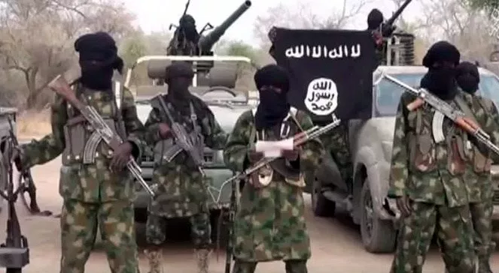
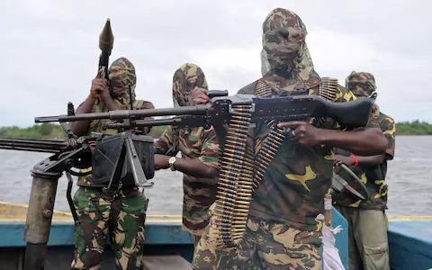
OVERVIEW OF SECURITY AGENCIES AND THE MEDIA IN NIGERIA (Cont)
Security Agencies:
These security agencies in collaboration with other paramilitary and response agencies, have in contemporary times been called upon to tackle or react to threats of militancy, kidnapping, communal and religious violence as well as terrorism
Altogether, the military and other security forces are engaged in essential tasks required for meeting the internal security objectives of ensuring safety and security of Nigeria’s territory, its population and all critical infrastructure

Slide 28
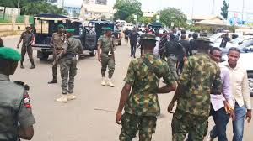
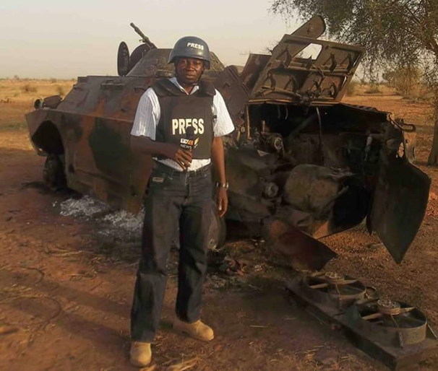
OVERVIEW OF SECURITY AGENCIES AND THE MEDIA IN NIGERIA (Cont)
Security Agencies:
The military and security agencies’ operations by their nature have specific strategic purposes or objectives which involve intervening in crisis situations by conducting internal security actions and any form of support to civil authorities
For an operation to have military or political significance, it should possess among other characteristics, good morale, training, surprise, good image of Commander and communications among others

Slide 29
OVERVIEW OF SECURITY AGENCIES AND THE MEDIA IN NIGERIA (Cont)
The Media:
Communication has remained a major force and indeed fundamental aspect of human activities thus making its presence a compelling need at all times
Communication and its type or forms from the beginning of time has continued to evolve in stages

Slide 30
OVERVIEW OF SECURITY AGENCIES AND THE MEDIA IN NIGERIA (Cont)
The Media:
Media is the means by which news and information is communicated to the public through the print and the airwaves
General usage now classifies it as Print (newspapers, magazines, journals, etc), Electronic (Radio and Television) and the New Media – news content made available through the use of internet and computer

Slide 31
OVERVIEW OF SECURITY AGENCIES AND THE MEDIA IN NIGERIA (Cont)
The Media:
Practitioners of this noble profession are called journalists, media men or press men
To be a professional journalist in Nigeria, one needs to be trained in school of journalism or be a graduate in mass communication and other similar qualifications

Slide 32
OVERVIEW OF SECURITY AGENCIES AND THE MEDIA IN NIGERIA (Cont)
The Media:
The news media is a curious instrument. While the media (most especially the social media) possess the ability to prevent a crisis from spreading out of control, organizations or government and its agencies cannot ignore its ability to aggravate an unfolding crisis situation
In other words, the media can be weapon of war and can also hold prospects for peace

Slide 33
OVERVIEW OF SECURITY AGENCIES AND THE MEDIA IN NIGERIA (Cont)
The Media:
In the hands of insidious interests, totalitarian governments and terrorist organizations alike, the media can be a veritable device for spreading hate messages of strange ideologies, religious extremism, negative politics and variants of misinformation which tend to manipulate public sentiments.

Slide 34
OVERVIEW OF SECURITY AGENCIES AND THE MEDIA IN NIGERIA (Cont)
The Media:
The use of government-controlled media to foment genocide in Rwanda in 1994 and the ethnic hatred propagated by Serbian State on its broadcasting system in Bosnia are typical examples of media falling into the wrong hands

Slide 35
OVERVIEW OF SECURITY AGENCIES AND THE MEDIA IN NIGERIA (Cont)
In an ideal environment, the media is supposed to be independent and very responsible according to its professional code of conduct. However, this is not always the case. In developing and less developed countries, media reports are associated with bias, inaccurate news reporting and sensationalism which at times generate violent conflicts.

Slide 36
OVERVIEW OF SECURITY AGENCIES AND THE MEDIA IN NIGERIA (Cont)
The Media:
Inspite of the above accounts, it is pertinent to note that the Nigerian media has played a more positive role in our national development than whatever negative influence it may have impacted in our march to nationhood
From the time of nationalist struggles for independence by our founding fathers up to the struggle for democracy from military rule and the sustained agitation for good governance, the Nigerian media has always played key roles in galvanizing public sentiments and support

Slide 37
OVERVIEW OF SECURITY AGENCIES AND THE MEDIA IN NIGERIA (Cont)
The Media:
A recent case in point is the last general election when the media, particularly the social media, were quite instrumental in informing and shaping opinions of Nigerians

Slide 38
OVERVIEW OF SECURITY AGENCIES AND THE MEDIA IN NIGERIA (Cont)
The Media:
The media therefore is a veritable tool for socio-political change and effective instrument for crisis management and conflict resolution
When it conforms to its own professional ethics such as accuracy, objectivity and balanced reportage, the media can have an influence on peace-building
It can enable citizens to make well-informed decisions in their own best interest

Slide 39
OVERVIEW OF SECURITY AGENCIES AND THE MEDIA IN NIGERIA (Cont)
I want to emphasise that the media as a strategic institution, demands credibility from those who may want to use it to advance the course and cause of peace and conflict resolution. Credibility is everything as far as information is concerned. Credibility is synonymous with influence and trust, and this means the ability to stick to the truth.

Slide 40
OVERVIEW OF SECURITY AGENCIES AND THE MEDIA IN NIGERIA (Cont)
Investigative Journalism:
From my own perspective, investigative journalism is that type of journalism in which reporters deeply investigate or single out topic of interest such as serious crimes, political issues, corruption matters or corporate wrong doings, amongst others
An investigative journalist may spend months or years researching and preparing a report in public interest

Slide 41
OVERVIEW OF SECURITY AGENCIES AND THE MEDIA IN NIGERIA (Cont)
Investigative Journalism:
Investigative journalism exposes abuse of power and betrayal of public trust by government or its officials, business concerns and issues affecting the society at large
Investigative journalism critically contributes to freedom of expression, check abuse of power/office by ensuring all institutions of the state whether public or private adhere to laid down norms which are the cornerstone of modern democracy

Slide 42
OVERVIEW OF SECURITY AGENCIES AND THE MEDIA IN NIGERIA (Cont)
Investigative Journalism:
Investigative journalism provides truth about people from government and other entities such as public corporations who attempt to keep their illegal activities very secretive
Its purpose is to expose such actions so that those involved can be held accountable
Investigative journalism requires the reporter to dig deeply into an issue or topic of interest - David Kaplan, Executive Director of the Global Investigative Journalism Network (GIJN)

Slide 43
OVERVIEW OF SECURITY AGENCIES AND THE MEDIA IN NIGERIA (Cont)
Investigative Journalism:
“… Investigative journalism is not instantaneous. It develops through recognised stages of planning, researching and reporting and has to adhere to accepted standards of accuracy and evidence. The base of an investigative story is the proactive work of a journalist and, where resources permit, his or her team. After receiving a story tip, journalists develop hypotheses, plan additional research, decide on the relevant questions, and go out to investigate them. … The final story should reveal new information or assemble previously available information in a new way to reveal its significance”
- David Kaplan, Executive Director of the Global Investigative Journalism Network (GIJN)

Slide 44
OVERVIEW OF SECURITY AGENCIES AND THE MEDIA IN NIGERIA (Cont)
Investigative Journalism:
One can argue that there is a dearth of investigative journalism in Nigeria as many journalists now prefer easy way out by relying on hearsay or the internet for their news sources
However, we have also seen very daring, thoroughly executed investigative works by Nigerian journalists who through their bravery have exposed underhand practices in public and private enterprises

Slide 45
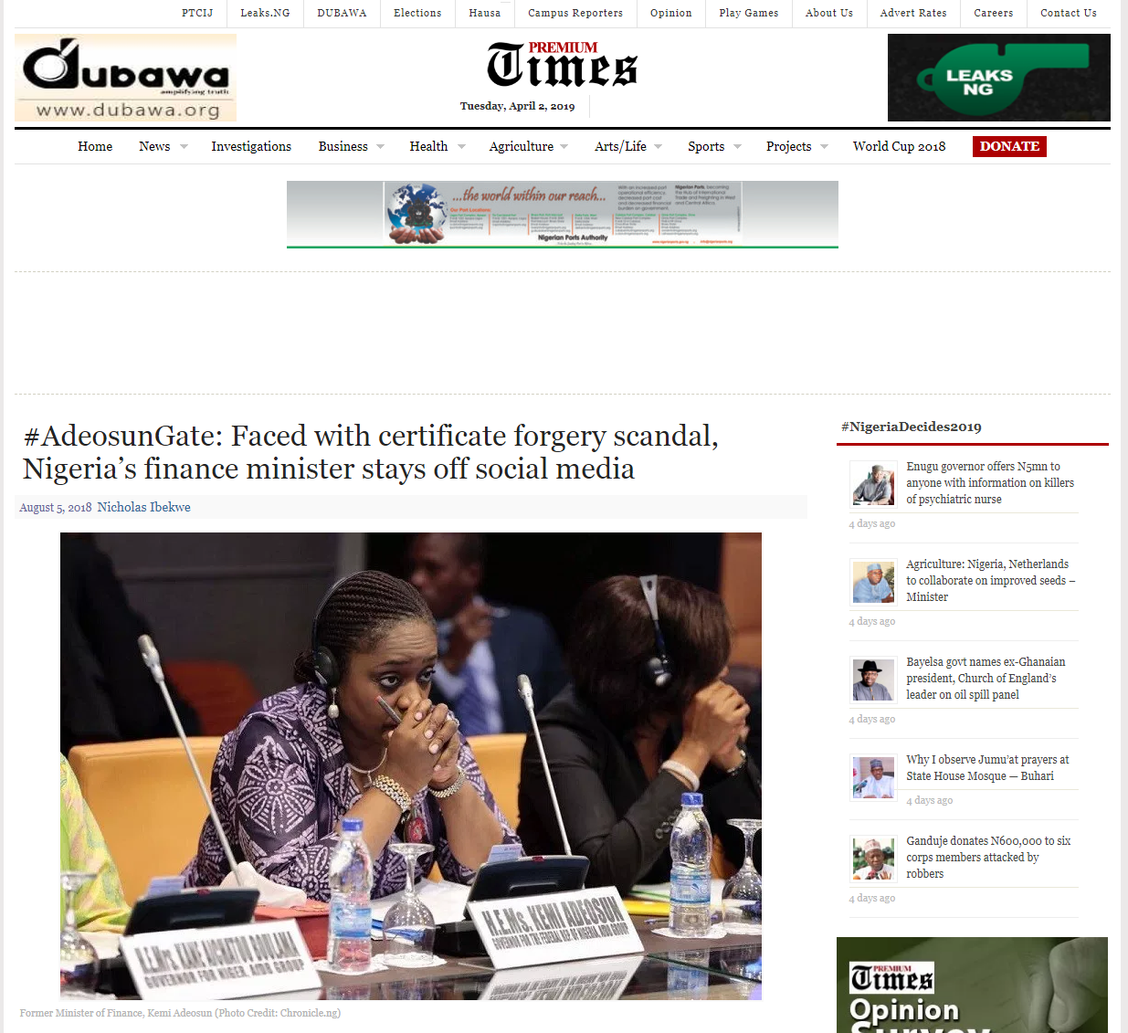
OVERVIEW OF SECURITY AGENCIES AND THE MEDIA IN NIGERIA (Cont)
Investigative Journalism:
We remember the exploits of the Premium Times investigative reporter who uncovered the non participation in the NYSC scheme by some top government functionaries

Slide 46
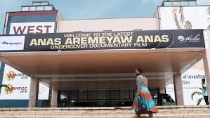
OVERVIEW OF SECURITY AGENCIES AND THE MEDIA IN NIGERIA (Cont)
Investigative Journalism:
In nearby Ghana, an investigative journalist, Anas Aremeyan Anas exposed a number of bribe-taking judges and some referees of their national football association which led to the sacking of some judges

Slide 47
OVERVIEW OF SECURITY AGENCIES AND THE MEDIA IN NIGERIA (Cont)
In a nutshell therefore, a robust investigative journalism is a crucial part of democracy as it can prompt official enquiries, influence changes or result in greater transparency and accountability in governance.

Slide 48
THE RELATIONSHIP BETWEEN SECURITY AGENCIES AND THE MEDIA

Slide 49
THE RELATIONSHIP BETWEEN SECURITY AGENCIES AND THE MEDIA
Over the years, especially during the successive military regimes, the relationship between the media and security agencies was anything but cordial
The security agencies are saddled with the responsibilities of pursuing national security that is assigned to it by the constitution
Given secrecy as a strategic value for the execution of military operations, the military is understandably reluctant for opening up to the media or the public.
The military do not trust the media especially against the background that it had been a victim of malicious journalism in the past
Since the advent of the current democratic dispensation, especially with the enactment of Freedom of Information (FoI) Act, the security agencies have been compelled to be more open and be more accountable to the people

Slide 50
THE RELATIONSHIP BETWEEN SECURITY AGENCIES AND THE MEDIA (Cont)
Media coverage of security agencies’ operations has often posed serious paradoxes between the public’s right to know and the need to protect national security interests
The public’s right to know stops exactly where it jeopardizes national security interest
All nations regardless of the type of government they operate, seek to protect their national security interests
Whereas it is universally accepted that freedom of the press forms the bedrock of a democratic and egalitarian society; it is equally an acknowledged fact that such freedom carries with it some social responsibility all in the greater interest of national security

Slide 51
THE RELATIONSHIP BETWEEN SECURITY AGENCIES AND THE MEDIA (Cont)
It is based on the need to ensure that the right to freedom of expression is not abused or misused that laws are enacted to guide the conduct of media profession
It is worthy of note that the security of the media practitioner, government and security agents are all essential aspects of the new thinking in national security
When a journalist is assaulted by security agencies in the course of performing his duty, it poses a threat to national security because the physical security of the media practitioner is part of the security calculus of the nation

Slide 52
THE RELATIONSHIP BETWEEN SECURITY AGENCIES AND THE MEDIA (Cont)
If a media house publishes or broadcasts information which incites one group against another in the country or one country’s citizen against the other, this could also be a threat to national security
If a section of the media publishes or broadcasts secret information or fabricates one about the size, equipment, deployment or state of preparedness of the military during an operation, this could jeopardise national security

Slide 53
THE RELATIONSHIP BETWEEN SECURITY AGENCIES AND THE MEDIA (Cont)
Positive sides of the relationship between the media and security agencies:
Since the inception of the current democratic order in 1999, the security agencies have been made to become submissive to the constitution and by extension political control
Over the years, the security agencies have made efforts to properly accredit journalists to cover their activities
A League of Defence Correspondents was established with properly accredited journalists to cover the defence beat

Slide 54
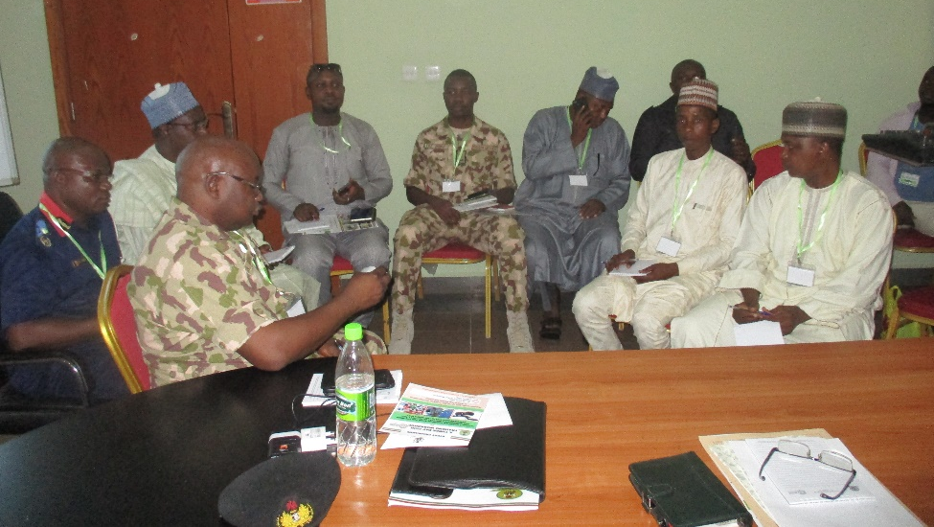
THE RELATIONSHIP BETWEEN SECURITY AGENCIES AND THE MEDIA (Cont)
Positive sides of the relationship between the media and security agencies:
Efforts have been made by security agencies particularly the military to carry-out conferences, seminars and workshops to appraise the media reporters on the activities, workings and protocols of the security agencies
The military has also made concerted efforts to carry journalists along on security facility visits to familiarize them on some of its operations and where possible they get embedded, especially in the ongoing fight against terrorism in the North East, all in a bid to open-up on their activities

Slide 55
THE RELATIONSHIP BETWEEN SECURITY AGENCIES AND THE MEDIA (Cont)
Where then are the Conflict areas in this relationship?
Let me borrow from political scientists and say that since the dawn of mankind, conflicts are identified as part of the dynamics of human societies at the individual, community, state and national levels
Conflicts between security agencies and the media in Nigeria are usually value laden
There are several instances of minor and major disagreements between both parties on what is reported, how it was reported and why it was reported
For example, media coverage of annual report by Amnesty International criticism on the military operation in the ongoing fight against terrorism is often seen as unpatriotic

Slide 56
THE RELATIONSHIP BETWEEN SECURITY AGENCIES AND THE MEDIA (Cont)
It is therefore not unexpected that in carrying out their core mandates, there are bound to be occasional clashes of interest between the two. A few examples may suffice in this regard.

Slide 57
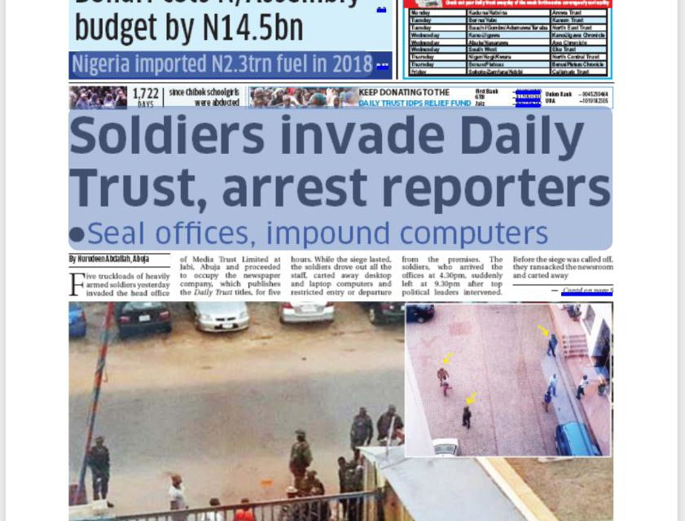
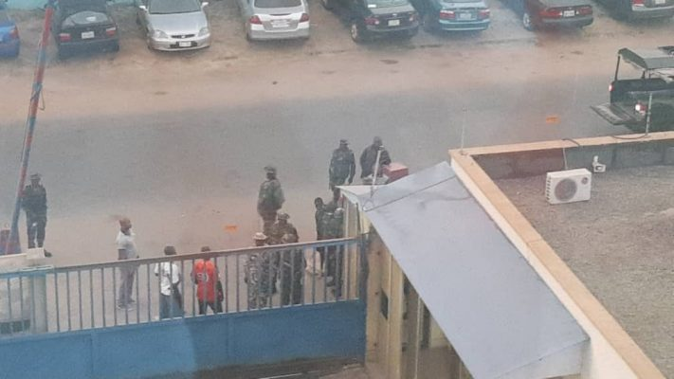
THE RELATIONSHIP BETWEEN SECURITY AGENCIES AND THE MEDIA (Cont)
Where then are the Conflict areas in this relationship?
We may recall the recent altercation on the 6th of January 2019 between the Media Trust publishers of Sunday Trust newspapers and the Nigerian Army which led to the invasion of the premises of the former by the latter. The paper ran a lead story headlined “Military prepares a massive operation to retake Baga, others”. Obviously, the story detailed out how troops were being mobilized and their locations.
Sunday Trust in that publication added “More troops including ground troops, airmen and naval personnel are being deployed from different formations. They will join those on the ground in Borno, Yobe and Adamawa states for the operations”. No doubt, that was a good example of investigative journalism any day anywhere. You will recall that by the evening of that day, the Nigerian Army invaded the headquarters of the Media Trust in Abuja and Maiduguri. The rest is now history.

Slide 58
THE RELATIONSHIP BETWEEN SECURITY AGENCIES AND THE MEDIA (Cont)
Where then are the Conflict areas in this relationship?
In this case, the military felt that their operational secrets and mission were jeopardised and exposed the impending military operation against some targeted Boko Haram terrorists in the North East
The question which I want an answer during the interactive session “Should the newspaper have published the story?
The Nigerian Prison Service Riot and bomb blast of 2016 was another example of good, investigative journalism that puts a security agency of the government on the spot and there are many other such examples

Slide 59
THE WAY FORWARD

Slide 60
THE WAY FORWARD
The power of the security agencies does not in any way diminish the potent power of the pen
The media accords legitimacy to public issues and sets an agenda to determine the prevailing public opinion on topical or mundane issues
It is the attention that journalists give to critical issues that determine the value and interests the public will show towards such issues
It is logical to argue that whatever issues the media ignore in their reports are considered irrelevant by the members of the public
Therefore, both the actions and inactions of the media regarding any important public issue have some kind of meanings when evaluated within the court of public opinion.

Slide 61
THE WAY FORWARD (Cont)
The media plays a key role in the success or otherwise of any military operation or conflict resolution mechanism
Journalists as gate-keepers should guard against sensationalism and speculations
A professional journalist should clarify and verify information before going to press
There is the need for more of investigative journalism not only as it concerns security agencies but all our major institutions in Nigeria
We need to continue to build a culture of accountability by the security agencies and other institutions of government by the media through normal reportage or investigative journalism

Slide 62
THE WAY FORWARD (Cont)
We have seen that as purveyors of news and information, the media plays critical role in the protection or desecration of the national security interests.
The security agencies and the media therefore understand that national security is better served through collaboration with each other than through antagonism.

Slide 63
CONCLUSION

Slide 64
Thank you all for listening

Slide 65
References
DeChurch, LA & Marks, M.A (2001): Maximizing the Benefits of Task Conflict: The role conflict management, International Journal of Conflict Management.
Kuhn, T & Poole, MS (2000): DO Conflict management Style Affect Decision Making? (Human Communication Research), London.
Pruitt, DG (1983), Strategic Choice in Negotiation (American Behavioral Scientists)
Maho, A. (2014). Boko Haram, the Nigerian media and the failure of reporting. Seminar paper University of Abuja, Nigeria.
AA Gadzama, “Intelligence Gathering in Crisis Situation” a paper presented at the National Defence College on 31 May 2006.
Prof Ikechukwu Nwosu, FNIPR “Effective Media Relations, Issues, Strategies and Dynamics” Public Relations Management Series 1 (Lagos: Zoom Lens Publishers 2005) p. 24-25.
Olusegun Adeniyi, The Media and Security Information Management, Workshop Paper presented at MOD Workshop, 23 March 2019.

