Slide 1
INVESTIGATING THE POWER SECTOR
BY
THEOPHILUS ABBAH

Slide 2

What is Investigative Reporting?
Investigative Reporting is newspaper or broadcast journalism with focus on long-term efforts to uncover corruption or misconduct, especially by public institutions and government.

Slide 3
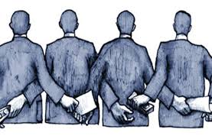
Investigative Reporting
Investigative reporters uncover facts and write articles that expose waste, wrongdoing, mismanagement, fraud, conflict of interest and abuse of authority. The stories promote change and reform.

Slide 4

Investigative Reporting
Uncovering something somebody wants to keep secret.
Investigative journalists are prepared to look beyond what is conventionally acceptable, behind the interpretations of events provided for us by authority and the authoritative

Slide 5
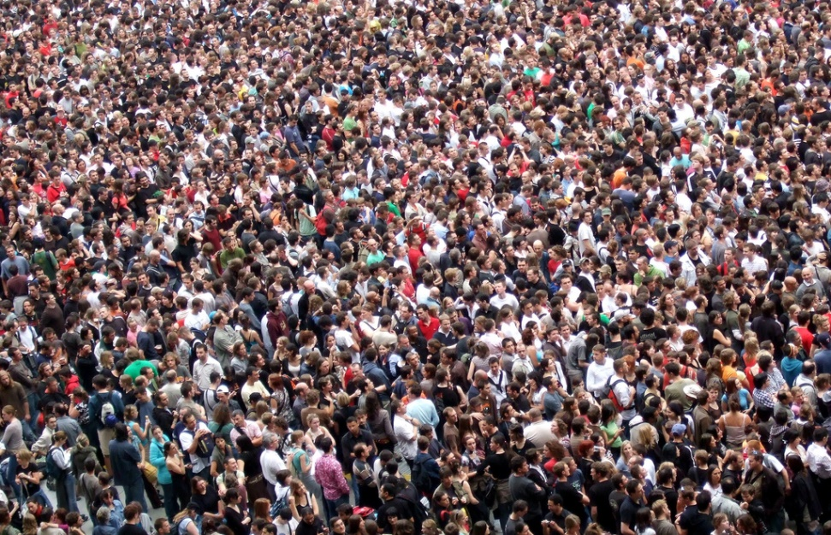
Public Interest
It’s a crucial duty of journalists to serve public interest by acting as a watchdog on government, business, education, health, environment, safety and other institutions.

Slide 6
Public Interest
The public expects journalists to expose rot and corruption. Government, business organizations, lawmakers, traditional institutions are waiting for journalists to expose corruption. Publicity is the antidote to corruption

Slide 7
Story Ideas?
Your own experience
Experience of friends and family
Roadside radio – gossips and anecdotes of street traders, taxi drivers and passengers
Whistleblowers; complainants
Local newspaper reports
Follow-up stories
Reading and surfing the web: what similar stories to the ones who have read can you do?

Slide 8
Story Ideas?
Checking public information: When there is a press release about events, persons, policies, is it possible to dig deeper into the background of the people/issues?
A tip off – ‘leak journalism’
Government documents: budgets, gazettes, annual reports, investigative panel reports, , etc

Slide 9
It’s scientific
An investigative story must be scientific. How?
There is the story idea (from documents, radio, beer parlour, parliamentary debate, etc.)
You form your hypothesis of what you need to find out and how
You study what others have written about the story you’re working on (like Literature Review)
Talk to Experts
Go There: Enter the field to find out things for yourself.
What did you uncover? What is new? What is the evidence of what you claimed to have discovered?

Slide 10

What is Solutions Journalism?
Solutions Journalism Network (SJN), defines it as: “rigorous, compelling coverage of responses to social problems — reporting done with the highest of journalistic standards”

Slide 11
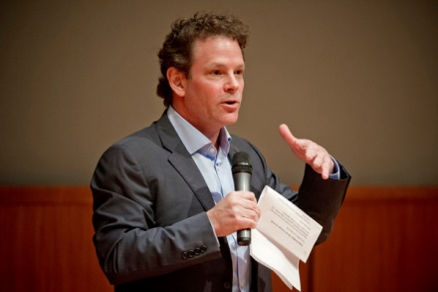
Origin
It was founded in 2013 by David Bornstein, Courtney E. Martin, and Tina Rosenberg.

Slide 12
Solutions Journalism
It’s central focus is solving social problems, using models and insight from experts. Checklist
Does the story explain the causes of a social problem?
Does the story present an associated response to that problem?
Does the story get into the problem solving and how-to details of implementation?

Slide 13
Solutions Journalism
Is the problem-solving process central to the narrative
Does the story present evidence of results linked to the response?
Does the story explain the limitations of the response?
Does the story convey an insight or teachable lesson?
Does the story avoid reading like a puff piece?: Solutions journalism is expressly not about advocating for particular models, organizations, and ideas. Journalists pursuing solutions stories are bringing their discernment to explore ideas and methods, not to advance an agenda or make people feel good.

Slide 14
Solutions Journalism
Does the story draw on sources who have a ground-level understanding, not just 30,000-foot expertise?
Does the story give greater attention to the response than to a leader/innovator/do-gooder?
It’s not a complaint; hero worship; favour for a friend; think tank; a afterthought attempt to write an answer which was not an element of the story

Slide 15

7 Steps to Writing a Solutions-based story

Slide 16
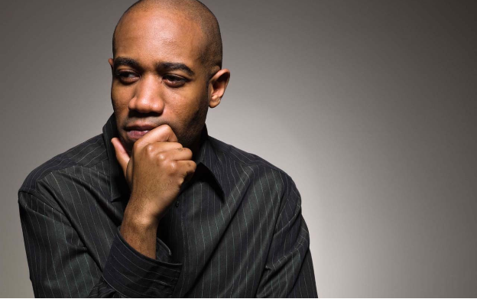
1. Identify a social problem
1. Identifying social problems that require solutions. E.g How to solve late-coming to schools

Slide 17

2. How does it affect the people?
Anecdotes, interviews, observations, and other ways of proving that it is a social problem

Slide 18

3. Gather relevant data
Look for data to support the level of seriousness of problems. Government, CSOs, academia, etc. Analytical reporting of the effects of the social problem on the people. Is it leading to closure of businesses? Is it cause health crisis? Is it creating conflicts in families?

Slide 19

4. Identify efforts already made to solve the problem
Identify efforts made by various actors to solve the problem: those involved in dealing with it. Find out how they have failed in solving the problem. You don’t just criticize, but acknowledge efforts.

Slide 20

5. Who has ever solved a similar problem?
Who has solved the problem? Find out how. Most times there are peoples who have solved the problem in the country or outside the country. To what extent did they do it, and under what climate?

Slide 21

6. Talk to Experts
Talk to experts in the sector to find out other approaches to solving the problem

Slide 22

7. State the way forward
A solutions story is emphatic about what next steps must be taken by who and how, in order to get rid of the social problem. You don’t just present the diverse views and leave a jigsaw to the reader to solve.

Slide 23
Investigative or Solutions?
Investigative
Expose wrong doers
Accountability
In-depth
Multiples sources
Multiple Evidence
Data, data, data
Solutions
Identify social problem
State the gravity of it
Generating heat
Look for models
Look for experts
Prescribe the way forward

Slide 24
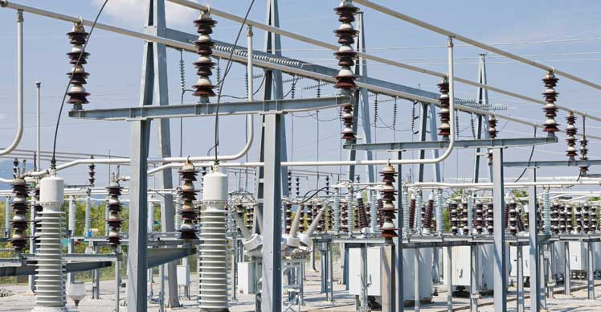
Power Sector: Investigative & Solutions Approach
This sector is very opaque, therefore, investigating it requires knowledge and insight. The following are some posers:

Slide 25
Power Sector
How much has government pumped into it?
Metering: Why is it difficult? How could be done better?
Are Nigerians getting value for the tariff they pay? How can they?
Rural Electrification Project: Is it working?
Who is destroying gas pipelines? Are they being punished? How can the pipelines be better protected?
Who are behind ‘estimated electricity bills,’ and how can victims seek redress?
In what state are the hydroelectric power stations: Kainji, Jebba, Shiroro, Zamfara, etc

Slide 26
Power Sector
Does NERC have the capacity to monitor Discos and Gencos?
Are the completed ‘electricity-related constituency projects’ working?
How reliable are the solutions to power problems: solar especially?
How are power outages affecting specific sectors?: data story
Why have we abandoned coal? How could they be revived?
How can government ensure that water sources to our hydroelectric power stations don’t dry up?

