Slide 1
Investigating Oil & Gas Sector in Nigeria
By
Theophilus Abbah
Managing Editor, Daily Trust

Slide 2
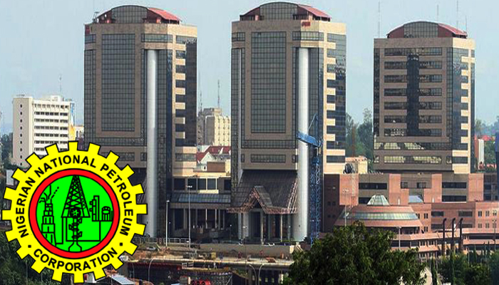
Importance of oil & gas
Notes:
Until the World Trade Centres, these were the three tallest buildings in Abuja. It’s symbolic

Slide 3
Why the sector is Importance
Nigeria is the largest oil producer in Africa
Oil is the energy of global economy. It lubricates motors and machines
Government revenue still depends on it – about 90%
Foreign Exchange earnings in Nigeria still depends on it
In Nigeria it contributes about 9%to the economy
It is in high demand because of the low sulfur content
Nigeria’s annual budget is hinged on earnings from the oil sector

Slide 4
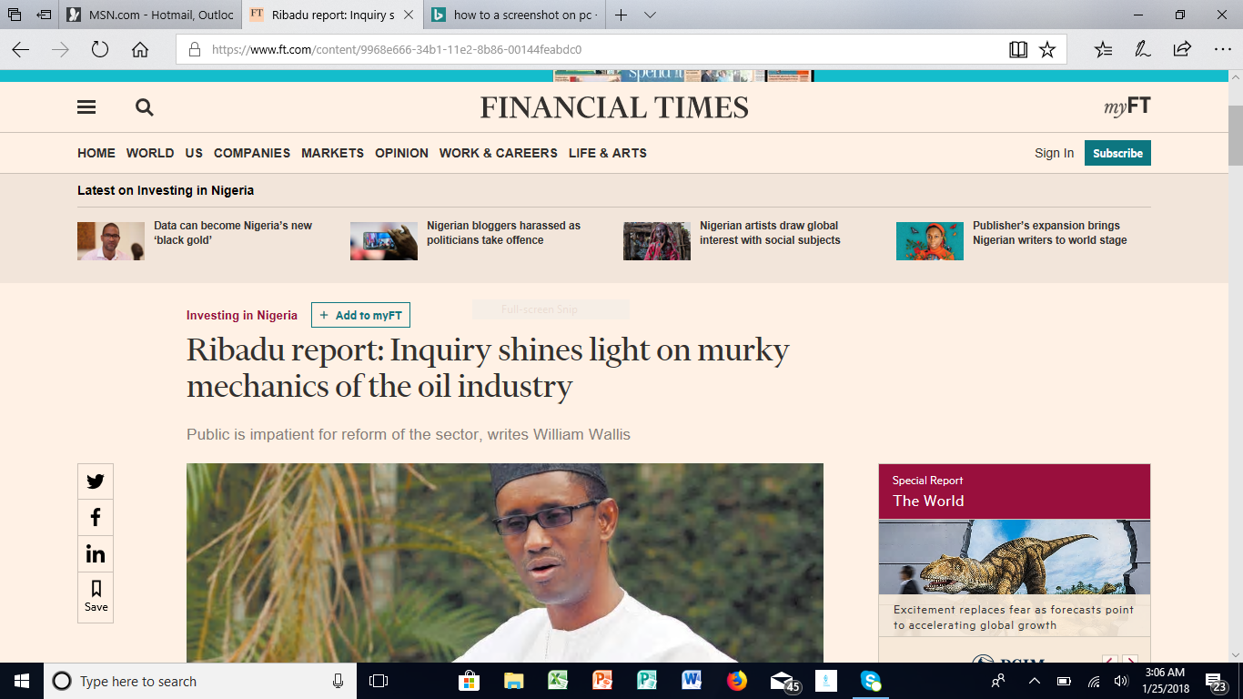
Oil & Gas and Investigative Reporting
Notes:
This is an evidence that the oil sector is too important to be left to NNPC

Slide 5
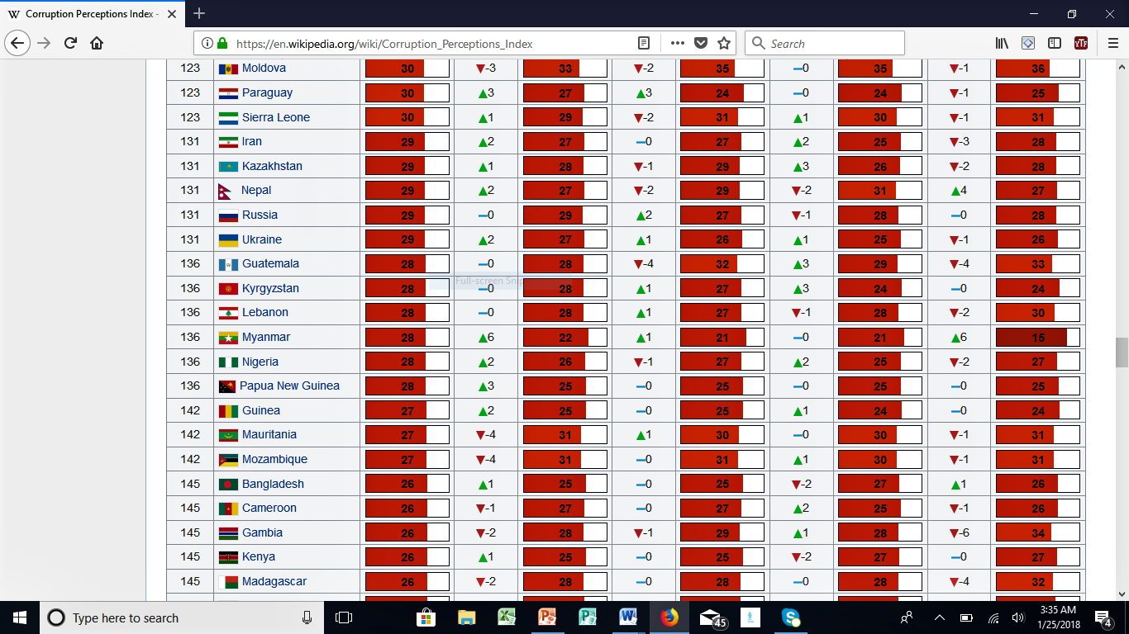
Oil & Corruption
Notes:
TI Corruption Index: Nigeria is 136 from about 170 countries

Slide 6
Investigative Reporting
The Investigative Reporters and Editors (IRE) describes it thus: Investigative reporters uncover facts and write articles that expose waste, wrongdoing, mismanagement, fraud, conflict of interest and abuse of authority. The stories promote change and reform.
The verb “uncover” comes as a crucial functional word here

Slide 7
Defining Investigative Reporting
Investigative Reporting is newspaper or broadcast journalism that focuses on long-term efforts to uncover corruption or misconduct, especially by public institutions and government. Microsoft ® Encarta ®
The focus here is the infinitive verb “to uncover”

Slide 8
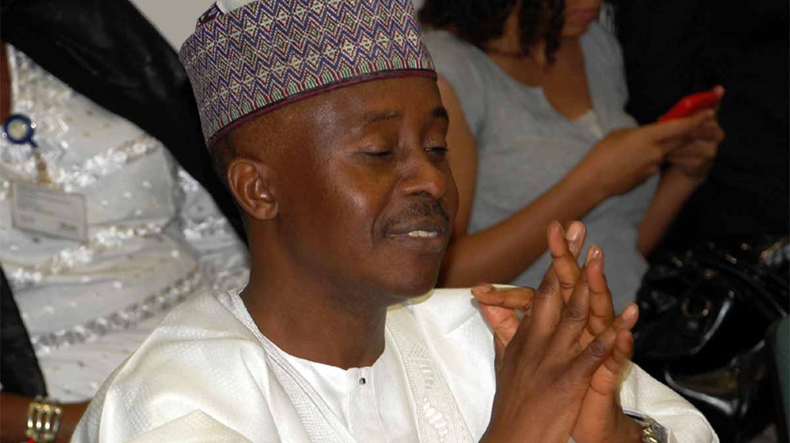
Farouk Lawan investigates oil fraud
Notes:
This lawmaker got sucked into corruption as his committee attempted to investigate oil fraud

Slide 9
Investigative Reporting
It’s the kind of journalism that reports what government or organisations do as against what they say.
Government says one thing, but does something different. Example: budgets
‘The reporting of concealed information.’
‘Uncovering something somebody wants to keep secret’
‘The journalism of outrage’
‘ Investigative journalists are prepared to look beyond what is conventionally acceptable, behind the interpretations of events provided for us by authority and the authoritative.’
Contemporary thoughts: It’s about showing trends and in-depth reporting. It may not necessarily demand exposing corruption, but highlighting issues to draw attention to them.

Slide 10
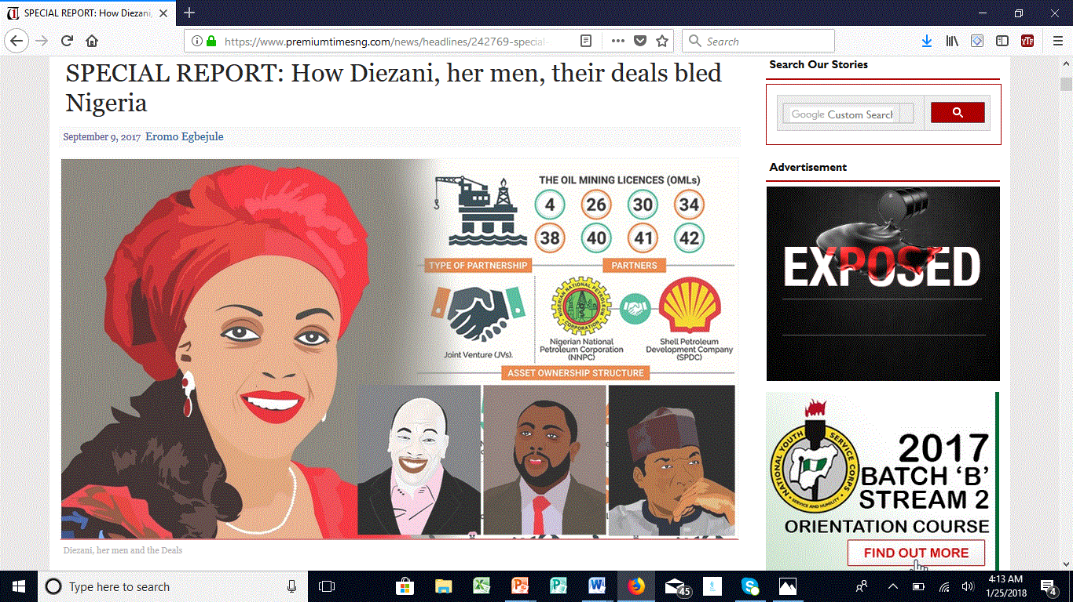
It takes courage to investigate
Notes:
https://www.premiumtimesng.com/news/headlines/242769-special-report-diezani-men-deals-bled-nigeria.html

Slide 11
Why bother to investigate?
IRE explains it thus: (1) It’s a crucial duty of journalists to serve the public interest by acting as a watchdog on government, business, education, health, environment, safety and other institutions.
It’s not about being used to run down someone
That duty is particularly important where agencies and institutions restrict the flow of information
“The investigative journalist digs beneath the surface to help readers understand what’s going on in a complex world” – Gene Roberts, Editor, New York Times

Slide 12
What the Constitution says
Chapter II section 22 of the 1999 constitution says:
The press, radio, television and other agencies of the mass media shall at all times be free to uphold the fundamental objectives contained in this chapter and uphold the responsibility and accountability of the government to the people.

Slide 13
Implications
Journalists serve as watchdogs to check the excesses of government
Journalists ensure government delivers on its promises
Government must allow journalists to tell the people what it is doing: Chapter II section 39 subsection (1) of the 1999 constitution states: Every person shall be entitled to freedom of expression, including freedom to hold opinions and to receive and impart ideas and information without interference

Slide 14
Constitution
Subsection (2) states that: Without prejudice to the generality of subsection I of this section, every person shall be entitled to own, establish and operate any medium for the dissemination of information, ideas and opinions.

Slide 15
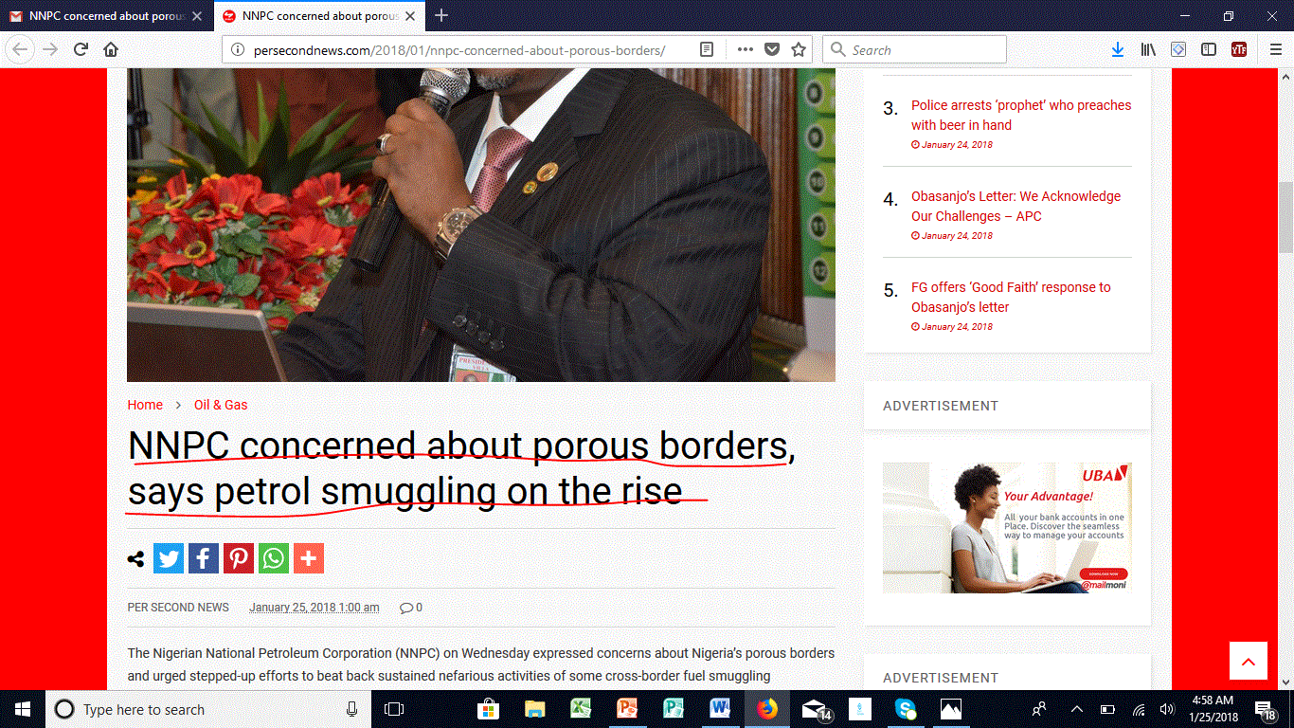
Today’s news: http://persecondnews.com/2018/01/nnpc-concerned-about-porous-borders/

Slide 16
An Approach to Investigative Reporting
An investigative story must be scientific. How?
There is the story idea (from documents, radio, beer parlor, parliamentary debate, etc.)
You form your hypothesis of what you need to find out and how
You study what others have written about the story you’re working on (like Literature Review)
Talk to Experts
Go There: Enter the field to find out things for yourself.
What did you uncover? What is new? What is the evidence of what you claimed to have discovered?

Slide 17
IJ Approach (contd)
Conventional Reporting
Investigative Reporting
Information is gathered and reported at a fixed rhythm (daily, weekly, monthly).
Research is completed swiftly. No further research is done once a story is completed.
The story is based on a necessary minimum of information and can be very short.
The declarations of sources can substitute for documentation.
Information cannot be published until its coherence and completeness are assured.
Research continues until the story is confirmed, and may continue after it is published.
The story is based on the obtainable maximum of information, and can be very long.
The reportage requires documentation to support or deny the declarations of sources.

Slide 18
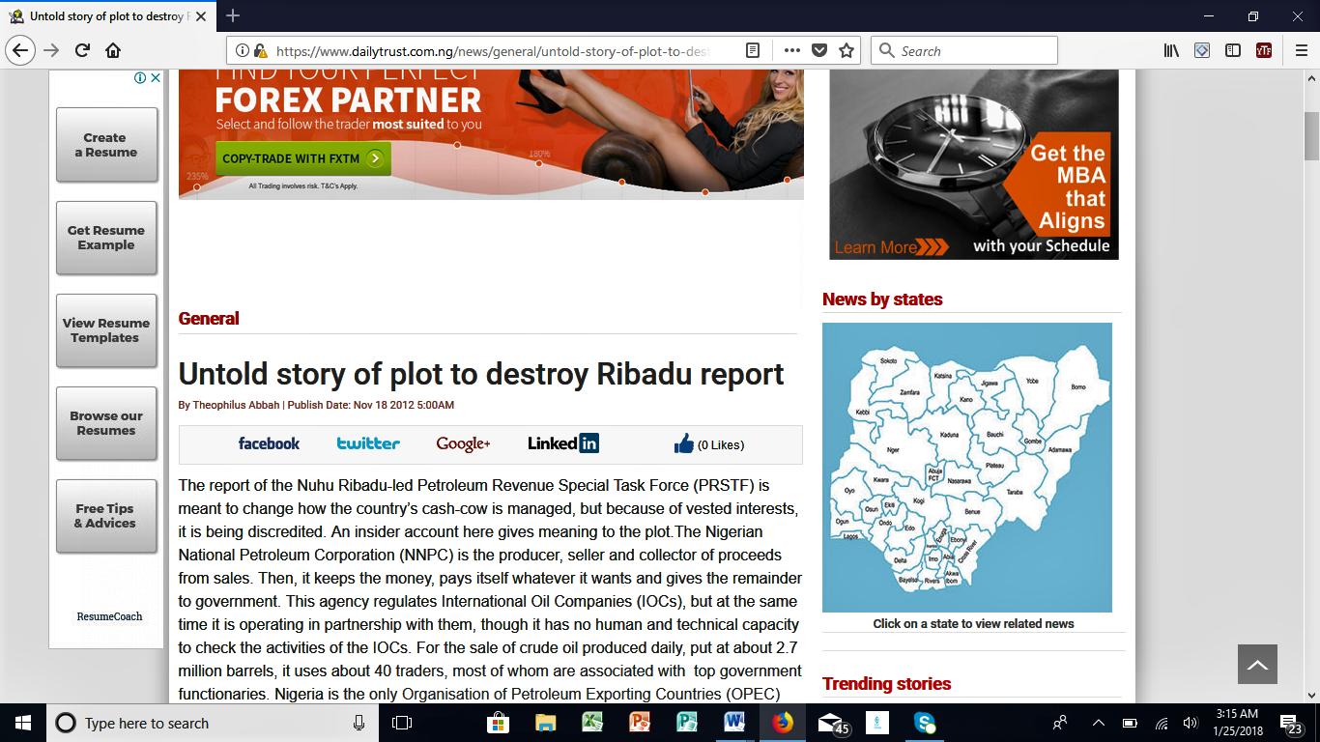
What Ribadu committee Recommended

Slide 19
Recommendation I
To increase government revenue from the industry, the Federal Government needs to put in place a coherent financing solution that allows government fund its obligations under the JV contracts. Funding government obligations will unlock additional capital from its JV partners, which will over time increase government’s revenue from the proportionate additional barrels of crude oil produced, royalties on the entire production and taxes on taxable income.

Slide 20
Recommendation II
“The FGN should take action and enforce collections of outstanding royalties amounting to billions of dollars from some of the oil companies operating in Nigeria. Mr President, we want these companies to do business in our country but we also want them to give us our entitlements. They make a lot of profit here and they go and Invest in other countries. The least they can do is to pay us the royalties, petroleum tax and penalties they owe.

Slide 21
Recommendation III
Nigeria is the only country in the world that uses traders to sell its crude oil. The only other country that is doing so is Congo Brazzaville. We should not be comfortable in this neigbourhood. This practise is a rip off and therefore should be stopped.

Slide 22
Recommendation IV
Increasing crude oil theft is a national tragedy with grave consequences and there is need for urgent action. That and general insecurity in the Niger Delta is denying us Foreign Direct Investment (FDI) in the industry. We have given some recommendations including Finger printing of Nigeria’s crude oil for us to be able to track stolen products.

Slide 23
Recommendation V
DPR needs to be appropriately positioned to regulate the petroleum industry and collect government revenue due from royalties for oil and gas production, gas flare penalties. DPR should be empowered to ensure the commencement of the fiscalisation of govt revenue from production and not sales as is the current practice

Slide 24
Recommendation VI
The Task force has recommended a comprehensive framework for automation of the industry for transparency and accountability and also fighting corruption at all levels in the industry. With corruption, nothing can be achieved. From my own experience, I want to tell you that if you are embarking on reforms, it must be with integrity otherwise it will fail.

Slide 25
Recommendation VII
We also recommend the establishment of an independent office for the transformation of the industry for a fixed term with a specific mandate to implement the reforms accepted by the govt based on the work of the various committees and task forces looking at the sector as well as other earlier reform initiatives in varying stages of implementation.”

Slide 26
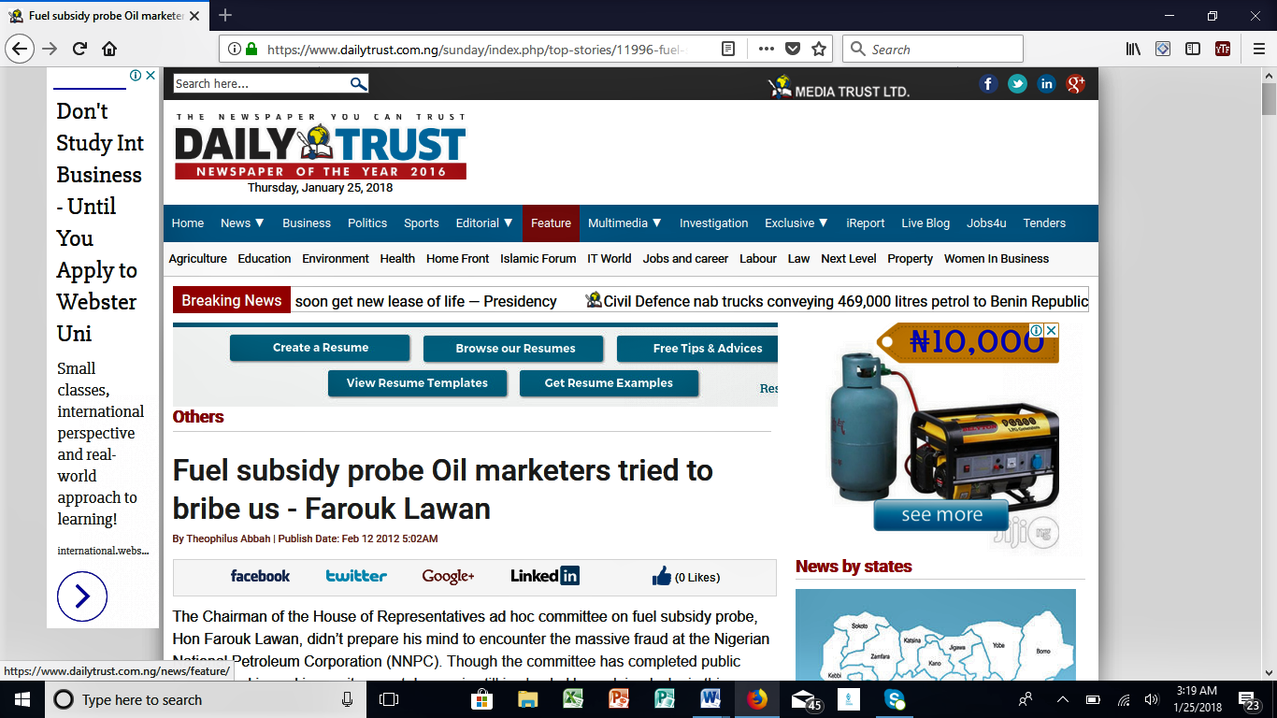
Beware!

Slide 27
THANK YOU & GOODLUCK!

