Slide 1
Principles & Practice of Investigative Journalism
Musikilu Mojeed

Slide 2
What’s Investigative Journalism
Investigative journalism involves exposing to the public matters that are concealed either deliberately by someone in a position of power, or accidentally, behind a chaotic mass of facts and circumstances that obscure understanding.
-- UNESCO Manual of Investigative Journalism

Slide 3
What’s Investigative Journalism
It requires using both secret and open sources and documents
-- UNESCO Manual of Investigative Journalism

Slide 4
Investigative Vs Conventional Journalism
Investigative Vs Conventional Journalism

Slide 6
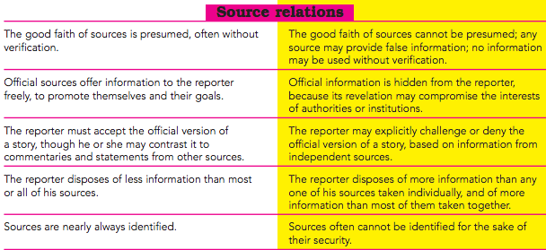

Slide 7
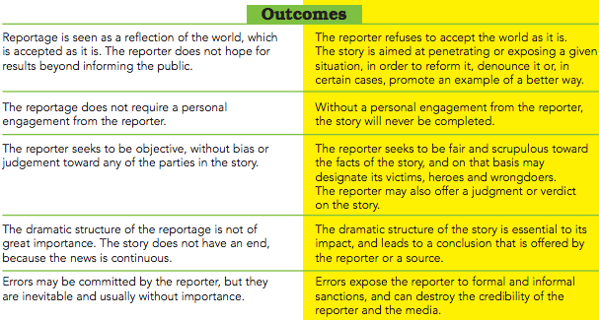

Slide 8
Neglected issues(1)
1) How federal and state governments spend security votes
Police inventory – cars, vans, buses, equipment, donation
Claims at Press Conferences
Announcement of Contract Awards: Who won the contract and was due process followed? For how much

Slide 9
Neglected issues (2)
How much does government spends on security
Performance of security-related contracts
Causes of crimes, what security precautions govt. fails to take

Slide 10
Starting Out
KNOW RELEVANT FED/STATE LAWS
Constitution
Appropriation Laws (Budgets)
Procurement Law
Police Act, Code of Conduct
Armed Forces Act
Terrorism Act etc etc

Slide 11
Know Databases
Know how to dig into databases on the web and analyse data.
Learn to use excel to analyse complex data.
Sign up for newsletters on some key websites so you know when there is an important update.

Slide 12
Investigate! Investigate!! Investigate!!!
Go to the field, build contacts and ask questions, questions.
Be patient, open minded and persevering as you investigate.
Investigation could be lonely/risky. Reporter must keep low key and blend with environment where he is operating

Slide 13
Qualities of an Investigative Journalist
Passion

Slide 14
Qualities of an Investigative Journalist
Curiosity

Slide 15
Qualities of an Investigative Journalist
Initiative

Slide 16
Qualities of an Investigative Journalist
Logical thinking, organisation and self-discipline

Slide 17
Qualities of an Investigative Journalist
Flexibility

Slide 18
Qualities of an Investigative Journalist
Teamworking and communication skills

Slide 19
Qualities of an Investigative Journalist
Well-developed reporting skills

Slide 20
Qualities of an Investigative Journalist
Broad general knowledge and good research skills

Slide 21
Qualities of an Investigative Journalist
Deep knowledge of laws, regulations, conventions etc

Slide 22
Qualities of an Investigative Journalist
Determination, Patience and Persistence

Slide 23
Qualities of an Investigative Journalist
Fairness and Strong Ethics

Slide 24
Qualities of an Investigative Journalist
Discretion

Slide 25
Qualities of an Investigative Journalist
Be able to avoid flippancy

Slide 26
Qualities of an Investigative Journalist
Citizenship – Sense of Service

Slide 27
Qualities of an Investigative Journalist
Courage

Slide 28
Qualities of an Investigative Journalist
Security Consciousness

Slide 29
Dangers Facing Investigative Journalists
Security Risk – Attacks, Murder

Slide 30
Dangers Facing Investigative Journalists
Sack

Slide 31
Dangers Facing Investigative Journalists
Isolation/Envy

Slide 32
Dangers Facing Investigative Journalists
Loneliness

Slide 33
Dangers Facing Investigative Journalists
Betrayal

Slide 34
Dangers Facing Investigative Journalists
Arrest, Detention, prosecution, jail

Slide 35
Advantages of being an Investigative Journalists
Serve society better

Slide 36
Advantages of being an Investigative Journalists
Shape policies, set agenda

Slide 37
Advantages of being an Investigative Journalists
Become a key and respected reporter in your newsroom

Slide 38
Advantages of being an Investigative Journalists
Put you among the elite corps of journalists in your newsroom, locality, country, continent, and even globally

Slide 39
Advantages of being an Investigative Journalists
Awards

Slide 40
Advantages of being an Investigative Journalists
You become resource person: request for your service from all over the world

Slide 41
Thank YOU!
Thank You!

