Slide 1
EDITING THE INVESTIGATIVE STORY
A
WORKSHOP
ORGANISED
BY
DAILY TRUST FOUNDATION
SUPPORTED
BY
MACARTHUR FOUNDATION
@
Chida Hotel
Utako District
Abuja

Slide 2
STRUCTURE OF THE INVESTIGATIVE STORY
BY
THEOPHILUS ABBAH, MANAGING EDITOR, DAILY TRUST

Slide 3
Introduction: A sea of materials
Interviews
Data
Experts
Explainers
Documents
Personal Experience
Infographs

Slide 4
How do I make the story interesting?
Chronologically
The story unfolds through time, sequence and actions, until it comes to a logical conclusion
Example:Emmanuel Maya’s story on the deadly journey migrants embark upon from Nigeria to Libya
Narratives
Following a situation through a period of time; following the actual investigation as it unfolds
Ingredients: Start from the most crucial action point; includes dialogue, powerful descriptions, bringing out contradictions, explainers, and ending memorably.
Process: This has to do with a lot of analysis: illustrations, directives, details step by step, the writer addresses the reader. It is basically expository

Slide 5
Examples:
Chronological: http://sunnewsonline.com/illegal-desert-journey-to-europe-how-nigerian-drowned-in-mediterranean-sea/
Narrative: http://www.dailymail.co.uk/news/article-5187241/Criminals-poisoned-anti-fracking-camp-protest.html.
Process: https://www.dailytrust.com.ng/news/feature/-local-rice-the-bitter-sweet-side-of-an-economy-driven-by-women/191284.html

Slide 6
Order of Presentation
Wall Street Journal
‘High Fives’ by Carol Rich
Start with a person or situation to set the scene between the case and the issues
Broadening out from that individual to deal with the bigger issues, through a ‘nut graph’ that explains the link between the individual and the larger issue
Returning to your case study for a human, striking conclusion
Examples: https://www.dailytrust.com.ng/sunday/index.php/news/17543-inside-the-massive-fraud-in-kogi-councils.
http://www.investigativecollective.com/nigeria-how-oil-elite-abandoned-the-farming-lands/.
News (What has happened or is happening?)
Context (What is the background?)
Scope (Is this an incident, a local trend, a national issue?)
Edge (Where is it leading?)
Impact (Why should your readers care?):
http://www.dailymail.co.uk/news/article-5187241/Criminals-poisoned-anti-fracking-camp-protest.html.

Slide 7
The Pyramid style
Start with a summary of the story’s theme
Foreshadow some of what you will discover
Walk step by step through your investigation, keeping the suspense alive and building the story to the dramatic/shocking end
Save the most important, dramatic information for last.
Read: https://newsdiaryonline.com/subsidy-probe-latest-monarchs-govt-officials-move-to-kill-report-reps-sunday-trust/

Slide 8
Think Visually
While doing the story, we must think of images and illustrations that should go into explaining the it
Maps
Graphs
Charts
Images/illustration
Photographs

Slide 9
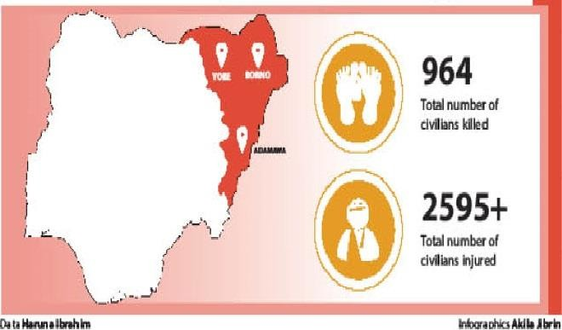
Think Visually :
Notes:
The map and images above illustrate this story: https://www.dailytrust.com.ng/boko-haram-kills-1-100-since-being-technically-defeated.html

Slide 10
Advantages
The map and images above illustrate this story: https://www.dailytrust.com.ng/boko-haram-kills-1-100-since-being-technically-defeated.html
It helps with pitching your story because it gives advance warning of any maps, charts, graphs or images that might be needed
It assists teamwork by aiding layout people and those who place stories on pages
It especially helps your temwork with photographic colleagues, laying the basis for conversations about what the best images for the piece would be and where you can draw on their expertise
It puts images in your head which you can then paint with words, such as for example, a scene-setter introduction.
It helps you communicate better with readers, who often learn far more from a well-chosen image or a striking chart than from text alone. An image, says the proverb ‘is worth a thousand words.’

Slide 11
How to ensure accuracy
Definition & Examples
Define jargons, complex or technical terms. Abstract concepts should be explained with concrete examples
Unproven Generalizations
What do you mean by ‘many’, ‘most’, ‘some’, ‘few’, ‘several’, ‘all’, ‘always’, ‘the reason’, ‘often’? You must be very specific. ‘N21.5 million was stolen’, not ‘millions was stolen’.
Supporting Arguments
Support all statements with concrete details. Bring out facts that back every allegation and arguments. An investigation MUST produce evidence, else the writer and editor will expose themselves to legal challenges

Slide 12
Accuracy (Cont’d)
Quoting Authorities as Proof
You must ensure that the report brings out the direct quotes that are crucial to your discovery. You must also bring the pros and cons, the explanations that is given for the fraud. Make sure you have multiple sources that are relevant to the story, not just one. Support the quotes with background information which you have researched into.
Beware of Prejudices, Stereotypes or Emotions
Keep your language neutral and treat all sources with respect. Provide evidence for what you say. Don’t say ‘All Fulani herders are killers’ or ‘All Igbo traders import fake products’. If an Igbo man imported fake products, name him. Focus on weight of evidence, solid proofs, not a single, clinching evidence
Establish Contexts
Everything happen in context. The job of an investigative journalist is to establish and explain the context in which a criminal or fraudulent act was committed. Why do many Nigerian youths risk their lives on the deadly journey to Europe? Unemployment. Why not tell your reader the frustration that Osasuwa passed through in Nigeria before he decided to take the risk to travel to Libya or Italy?

Slide 13
Link and Conclusion
Tie up loose ends: Explain what happened to the victims of the fraud? Tell us if he is alive or dead or suffering or triumphant at the end of your story
Summarize the theme once more to remind us why we are interested in the story
Create a ‘kicker’ (a sting in the tail that makes people think)
Emphasise context: Put the issues back into its setting and remind readers of hopes, constraints and linked developments
Go back to the people we met at the beginning, and let them have the last word.
Don’t say ‘only time will tell’. An investigator must find out something concrete, a definite resolution. You discourage your reader if you are waiting for time to tell the him the facts.

Slide 14
Revise your work
Revision is part of the writing process
Spell-check names. Don’t trust the computer so much
Did you provide evidence for all the claims?
Is the amount in Millions or Billions? Is it in Naira or Dollar or British Pounds or Euro?
Check the quotes. Are they correct?
Who said what? Was it the president or the minister of finance, or commissioner of environment?
Do the facts support the headline?
What did the story discover, expose, or explain? Does the story say anything new, for which a reader can pay?

Slide 15
Conclusion
Do the work of a Reporter, not an Opinion Writer.
Congrats!

