Slide 1
How to be a digital detective
Online fact-checking and verification
Presentation by Raymond Joseph,
GIJC ,Wits University, Johannesburg
November 2017

Slide 2
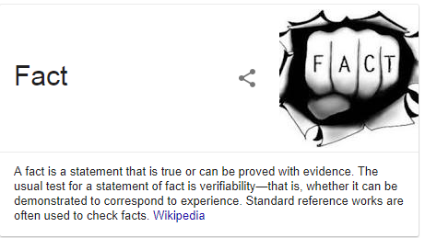

Slide 3
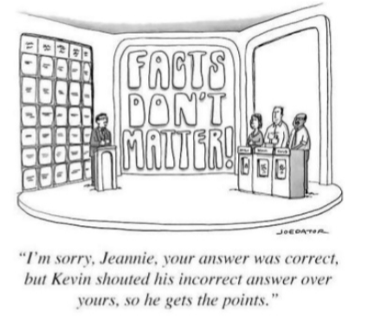
But fake often trumps truth because the messenger has the loudest voice

Slide 4
“Fake” come in many guises
Credit: Claire Wardle, FirstDraftNews

Slide 5
Source: IFLA www.goo.gl/SKxLMc

Slide 6
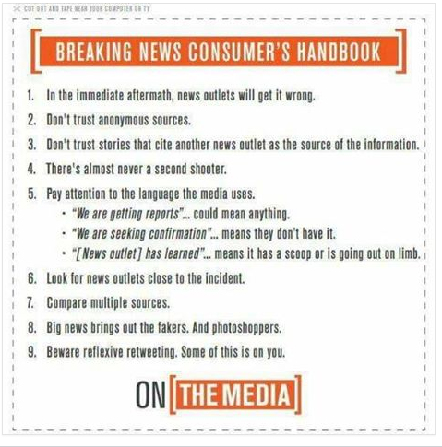
Food for thought

Slide 7
A few NB things to remember
If it’s fake, it can’t be news. Rather refer to mis- or disinformation;
Rather be right than risk getting it wrong in the race to be first;
Check thrice before you tweet/post once;
Fact-checking is not something you sometimes do; it’s part of your-day-to-day workflow as a journalist;
Never share unverified information without first fact-check the tweet or post;
It takes years to build your reputation, so don’t throw it away with a dumb or incorrect tweet or post;
Once it’s out there you can’t take it back;
If you get something wrong correct it immediately. Do it as a comment or post to the incorrect tweet or post so that the correction is linked to the error;
Beware! Real pictures from unrelated events are often used out of context when big news breaks;
Google Reverse Image Search, RevEye and TinEye are your best friends. Make them your first port of call;
Tools only do the heavy lifting – you still need to do the journalism

Slide 8
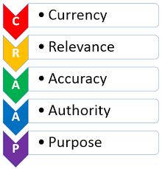
Assessing web sources
Notes:
Some basic criteria for evaluating web sources. Is it up-to-date? (Check when a story was first published) Why are we outraged now?) Is it relevant to your news needs? Is it free from grammatical and other errors and does it have references and identifiable sources? Google to check if any credible news sources corroborate the information? Who wrote the story and who published it? Do they have the right credentials? Known for good journalism? Finally, what is the purpose – is it meant to sway you towards an agenda? (Source: Britt McGowan and Amanda Ziegler, UWF Libraries)
Some basic criteria for evaluating web sources. Is it up-to-date? (Check when a story was first published) Why are we outraged now?) Is it relevant to your news needs? Is it free from grammatical and other errors and does it have references and identifiable sources? Google to check if any credible news sources corroborate the information? Who wrote the story and who published it? Do they have the right credentials? Known for good journalism? Finally, what is the purpose – is it meant to sway you towards an agenda? (Source: Britt McGowan and Amanda Ziegler, UWF Libraries)
Some basic criteria for evaluating web sources. Is it up-to-date? (Check when a story was first published) Why are we outraged now?) Is it relevant to your news needs? Is it free from grammatical and other errors and does it have references and identifiable sources? Google to check if any credible news sources corroborate the information? Who wrote the story and who published it? Do they have the right credentials? Known for good journalism? Finally, what is the purpose – is it meant to sway you towards an agenda? (Source: Britt McGowan and Amanda Ziegler, UWF Libraries)
Some basic criteria for evaluating web sources. Is it up-to-date? (Check when a story was first published) Why are we outraged now?) Is it relevant to your news needs? Is it free from grammatical and other errors and does it have references and identifiable sources? Google to check if any credible news sources corroborate the information? Who wrote the story and who published it? Do they have the right credentials? Known for good journalism? Finally, what is the purpose – is it meant to sway you towards an agenda? (Source: Britt McGowan and Amanda Ziegler, UWF Libraries)
Some basic criteria for evaluating web sources. Is it up-to-date? (Check when a story was first published) Why are we outraged now?) Is it relevant to your news needs? Is it free from grammatical and other errors and does it have references and identifiable sources? Google to check if any credible news sources corroborate the information? Who wrote the story and who published it? Do they have the right credentials? Known for good journalism? Finally, what is the purpose – is it meant to sway you towards an agenda? (Source: Britt McGowan and Amanda Ziegler, UWF Libraries)
Some basic criteria for evaluating web sources. Is it up-to-date? (Check when a story was first published) Why are we outraged now?) Is it relevant to your news needs? Is it free from grammatical and other errors and does it have references and identifiable sources? Google to check if any credible news sources corroborate the information? Who wrote the story and who published it? Do they have the right credentials? Known for good journalism? Finally, what is the purpose – is it meant to sway you towards an agenda? (Source: Britt McGowan and Amanda Ziegler, UWF Libraries)
Some basic criteria for evaluating web sources. Is it up-to-date? (Check when a story was first published) Why are we outraged now?) Is it relevant to your news needs? Is it free from grammatical and other errors and does it have references and identifiable sources? Google to check if any credible news sources corroborate the information? Who wrote the story and who published it? Do they have the right credentials? Known for good journalism? Finally, what is the purpose – is it meant to sway you towards an agenda? (Source: Britt McGowan and Amanda Ziegler, UWF Libraries)
Some basic criteria for evaluating web sources. Is it up-to-date? (Check when a story was first published) Why are we outraged now?) Is it relevant to your news needs? Is it free from grammatical and other errors and does it have references and identifiable sources? Google to check if any credible news sources corroborate the information? Who wrote the story and who published it? Do they have the right credentials? Known for good journalism? Finally, what is the purpose – is it meant to sway you towards an agenda? (Source: Britt McGowan and Amanda Ziegler, UWF Libraries)
Some basic criteria for evaluating web sources. Is it up-to-date? (Check when a story was first published) Why are we outraged now?) Is it relevant to your news needs? Is it free from grammatical and other errors and does it have references and identifiable sources? Google to check if any credible news sources corroborate the information? Who wrote the story and who published it? Do they have the right credentials? Known for good journalism? Finally, what is the purpose – is it meant to sway you towards an agenda? (Source: Britt McGowan and Amanda Ziegler, UWF Libraries)
Some basic criteria for evaluating web sources. Is it up-to-date? (Check when a story was first published) Why are we outraged now?) Is it relevant to your news needs? Is it free from grammatical and other errors and does it have references and identifiable sources? Google to check if any credible news sources corroborate the information? Who wrote the story and who published it? Do they have the right credentials? Known for good journalism? Finally, what is the purpose – is it meant to sway you towards an agenda? (Source: Britt McGowan and Amanda Ziegler, UWF Libraries)
Some basic criteria for evaluating web sources. Is it up-to-date? (Check when a story was first published) Why are we outraged now?) Is it relevant to your news needs? Is it free from grammatical and other errors and does it have references and identifiable sources? Google to check if any credible news sources corroborate the information? Who wrote the story and who published it? Do they have the right credentials? Known for good journalism? Finally, what is the purpose – is it meant to sway you towards an agenda? (Source: Britt McGowan and Amanda Ziegler, UWF Libraries)
Some basic criteria for evaluating web sources. Is it up-to-date? (Check when a story was first published) Why are we outraged now?) Is it relevant to your news needs? Is it free from grammatical and other errors and does it have references and identifiable sources? Google to check if any credible news sources corroborate the information? Who wrote the story and who published it? Do they have the right credentials? Known for good journalism? Finally, what is the purpose – is it meant to sway you towards an agenda? (Source: Britt McGowan and Amanda Ziegler, UWF Libraries)

Slide 9
Twitter verification basics
Use Foller.me to take a close look at the Tweeter’s account;
Try and speak directly to the source, ask for their off-Twitter contact details where you can speak in private;
Ask if they witnessed the incident first hand, or just heard about it;
Ask who else may be a witness?;
Ask if they have pictures or video?;
Does the tweet have a geo location?
Check the Exif data using this viewer. (be aware that social media platforms like Facebook and twitter strip out meta data);
Does the tweet sound authentic? Poor grammar, spelling and typos could indicate there’s a real person behind the tweet;
Use twXplorer to find the hash tags being used for a breaking story;
Google to see if anyone else is reporting or tweeting about it;
Crowdsource for info, ask questions
Check what people are wearing, vehicle number plates, any distinctive landmarks that can help you confirm
Check landmarks against Google Earth
Use WolframAlpha to check weather at the time and date of a tweet

Slide 10
Video verification

Slide 11
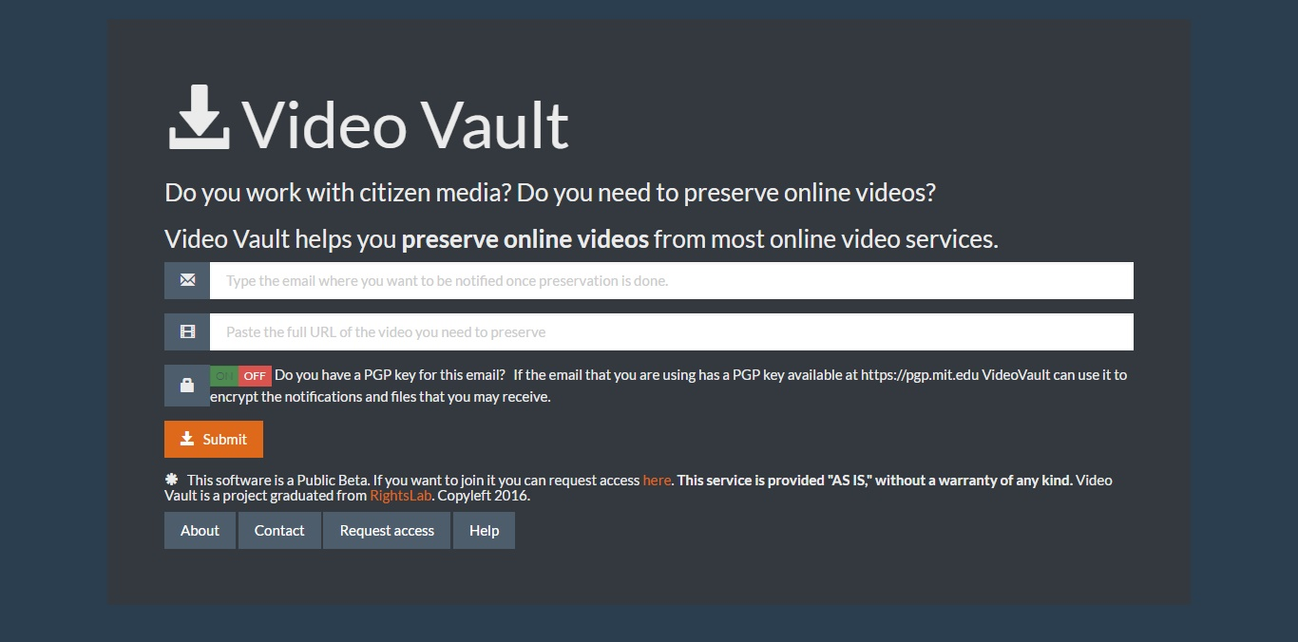
Video Vault

Slide 12
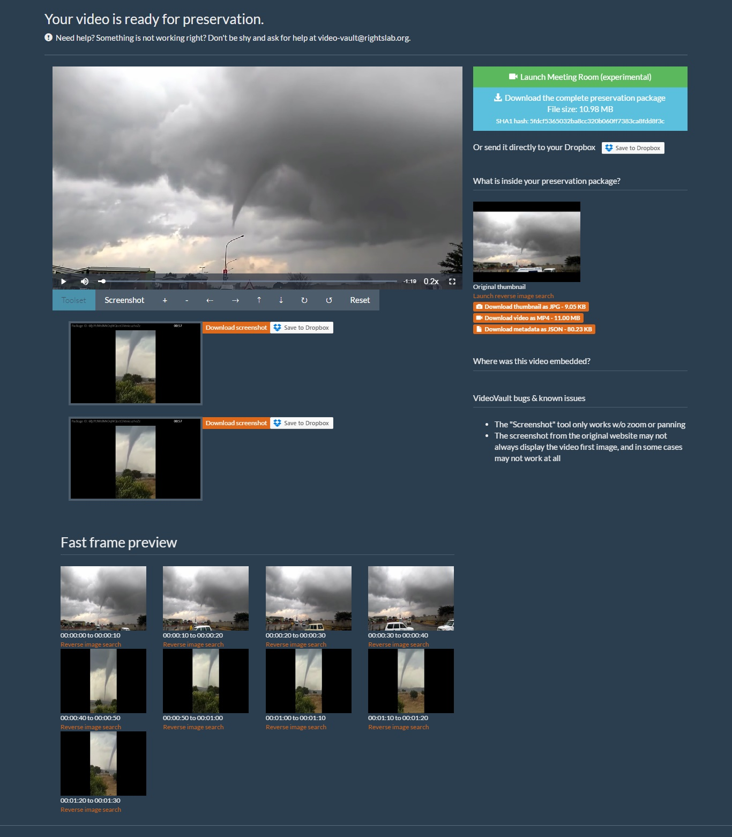

Slide 13
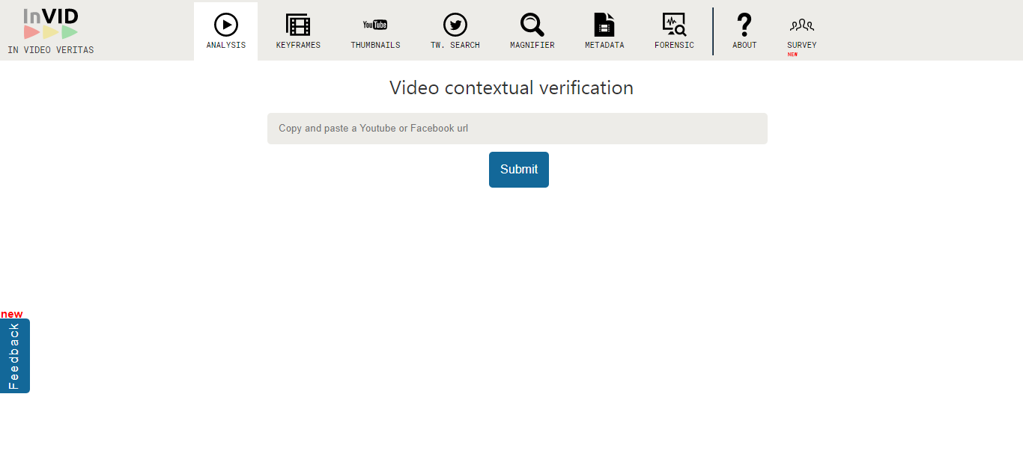
inVID for debunking fake videos

Slide 14
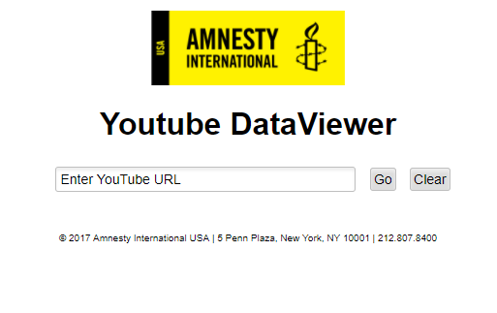

Slide 15
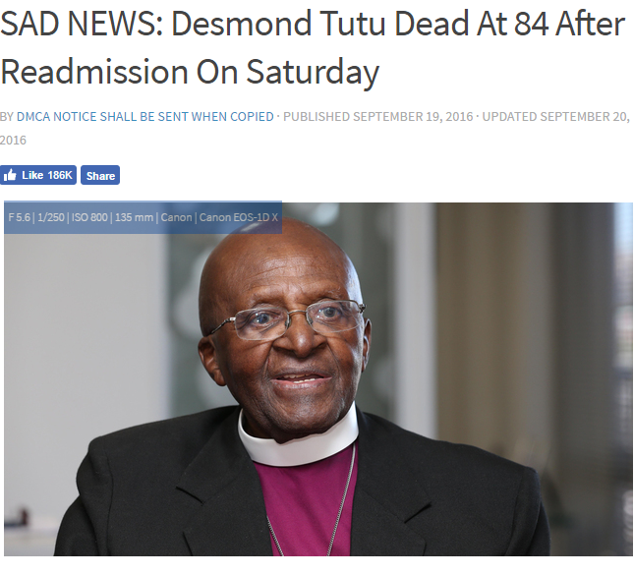
Look for subtle changes in the URL, like timeslive.co.za to t1meslive.co.za

Slide 16
and this …

Slide 17
Sometimes it’s a hoax. And often it’s click bait to drive traffic …

Slide 18
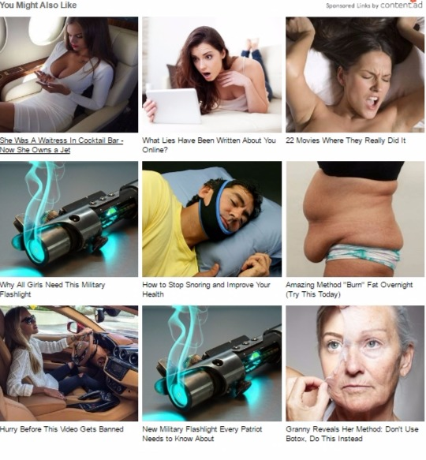
To rubbish like this
… with the cost of adverts calculated by the number of clicks the site gets

Slide 19
Image Verification Go-to tools

Slide 20
Google Reverse image search
Has it been published by a credible source? When was it first published?

Slide 21
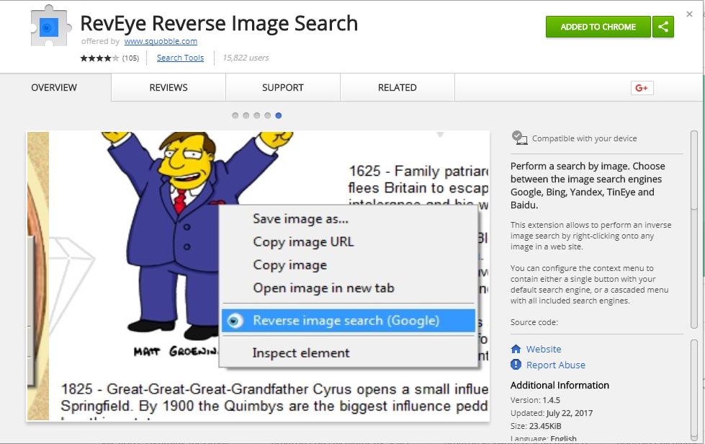

Slide 22
TinEye helps you find oldest, newest and most changed version of a picture

Slide 23
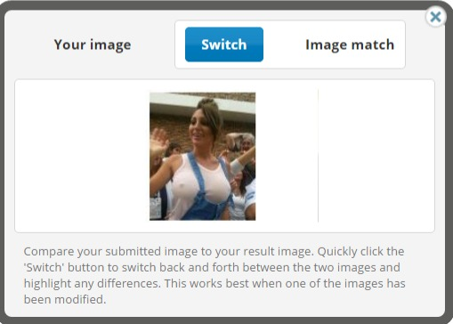
Like this Photoshopped picture that turned the Pope into a pervert

Slide 24
Verification
The first tweet about the attack on Osama Bin Laden
A search of the tweeters timeline proved he was a real person from that village who worked in IT

Slide 25
Don’t get caught, rather be right than rush to be first - and get it wrong

Slide 26
So your default should always be verify, verify, verify …

Slide 27
Now, let’s do some fact-checking
Go to: https://goo.gl/dEFpUv and check if the pictures are genuine or not, and if they’ve been changed in any way
What else can you find out about these photos?
Use Google Reverse Image Search, TinEye and RevEye) to take a closer look

Slide 28
Thank you Raymond Joseph Contact: Email: rayjoe@iafrica.com Phone: +27(0)83 264-5396 Twitter: @rayjoe

