Slide 1
INVESTIGATIVE REPORTING
BY
THEOPHILUS ABBAH

Slide 2

What is Investigative Reporting?
Investigative Reporting is newspaper or broadcast journalism with focus on long-term efforts to uncover corruption or misconduct, especially by public institutions and government.

Slide 3

Investigative Reporting
Investigative reporters uncover facts and write articles that expose waste, wrongdoing, mismanagement, fraud, conflict of interest and abuse of authority. The stories promote change and reform.

Slide 4

Investigative Reporting
Uncovering something somebody wants to keep secret.
Investigative journalists are prepared to look beyond what is conventionally acceptable, behind the interpretations of events provided for us by authority and the authoritative

Slide 5
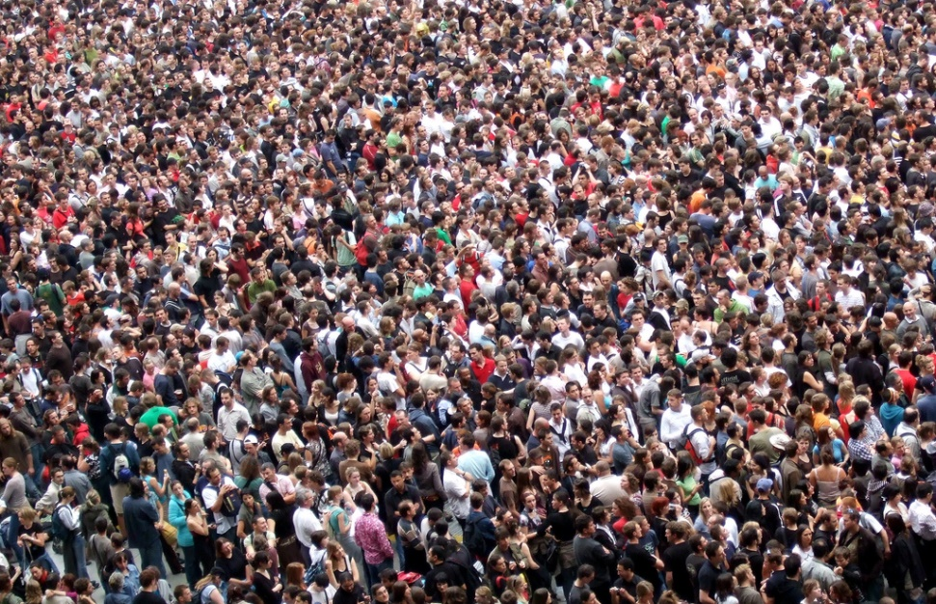
Public Interest
It’s a crucial duty of journalists to serve public interest by acting as a watchdog on government, business, education, health, environment, safety and other institutions.

Slide 6
Public Interest
The public expects journalists to expose rot and corruption. Government, business organizations, lawmakers, traditional institutions are waiting for journalists to expose corruption. Publicity is the antidote to corruption

Slide 7
Story Ideas?
Your own experience
Experience of friends and family
Roadside radio – gossips and anecdotes of street traders, taxi drivers and passengers
Whistleblowers; complainants
Local newspaper reports
Follow-up stories
Reading and surfing the web: what similar stories to the ones who have read can you do?

Slide 8
Story Ideas?
Checking public information: When there is a press release about events, persons, policies, is it possible to dig deeper into the background of the people/issues?
A tip off – ‘leak journalism’
Government documents: budgets, gazettes, annual reports, investigative panel reports, , etc

Slide 9
It’s scientific
An investigative story must be scientific. How?
There is the story idea (from documents, radio, beer parlour, parliamentary debate, etc.)
You form your hypothesis of what you need to find out and how
You study what others have written about the story you’re working on (like Literature Review)
Talk to Experts
Go There: Enter the field to find out things for yourself.
What did you uncover? What is new? What is the evidence of what you claimed to have discovered?

Slide 10
CSOs, JOURNALISTS AS ANTI-CORRUPTION PARTNERS
CSOs in Nigeria have been actively involved in anti-corruption activities by:
Exposing corruption and criticizing officials and institutions
Raising red flags about corruption-prone areas/sectors and calling for investigation.
Carry out investigations and publicizing them.
Some provide anti-corruption information/education to the public.

Slide 11
Anti-Corruption Roles of CSO
They suggest options available to government on dealing with corruption.
Some even propose new legislations in dealing with corruption issues.
Some monitor the activities of anti-corruption agencies’ activities and performances, and put them on their toes
They could engage in coalitions/collaborations in specific anti-corruption cases.

Slide 12
MEDIA & ANTI-CORRUPTION
One of the antidotes to corruption is publicity
Media creates perception in every society. Therefore they are critical in shaping the society perception of corruption.
Social media have come to amplify the options and complementary platforms available for increasing public perception
It is accepted that the media play the role of watchdog, monitor of govt, ensure accountability and transparency of governments and powerful factions.
Media provide the avenue for citizens to share their viewpoints on anti-corruption issues.

Slide 13
ENGAGING THE MEDIA
The first step is to identify the audience you want to reach: Big politicians (newspapers, television, social media, local and international press). Health, water, education (you may need to reach rural dweller) – Radio will be it.
Digital fraud? (you may target young people, urban, educated ) Social media (internet).
You often need a mix of the available media to be able to reach your audience.

Slide 14
Collaboration
Build a relationship with the media: reporters, editors and senior editorial staff.
It’s not just about pushing press releases, but engaging them meaningfully to ensure they buy into your anti-corruption project.
Identify journalists known for covering the corruption story you are working on. Identify editors and newspapers that do anti-corruption stories.
Do background conversations: meetings over tea, lunch or dinner. Let there be a buy-in of the journalists from the start of the investigation.

Slide 15
Collaboration
You could even seek their suggestion on how to carry out the investigation.
Engage them to do aspects of the investigation
Give them capacity training, where necessary.
Help them to form a network around the themes that you work upon. Journalists could see themselves as rivals, but given them a sense of purpose.
Sustain the coalition. It’s should not be a one-off relationship.

Slide 16
Support for media
Know that not all media organisations are interested in investigative reporting. So be ready to support those that do – investigative journalists are attacked by government and civil servants who benefit from corruption.
Help them to access information, using your contacts in government agencies.
Provide background training on issues being investigated. Let there be a kind of workshop where experts in those areas speak in order to help journalists clearly understand the perspectives.
Train them on research and analytical skills necessary for investigative reporting.

Slide 17
Support for media
You could institute awards around your area of investigation, so that journalists who do well could be rewarded – even with cash.
Know when to reach journalists: for TV, newspapers, radio before noon preferably. But ‘internet journalists’ could be called upon at any time as they break their news without delay.
Is it a story they can sell to their readers? Highlight the perspectives that are great in your press releases.

Slide 18
Your Press Release
How to frame your statement: what is new about your investigation? What is the highpoint of the investigation? How much was stolen? Who stole the money? What could that money have been used to improve the lots of the people?
Did you cover all sides? Did you challenge those involved in corrupt practices?
What methods did you use in carrying out your investigation? How credible it is? Do your statistical figures add up?
Beware of exaggeration!
What are you hiding? Don’t be deceptive.

Slide 19
Understanding the Newsroom
Reporter
News Editor
Editors
Features Editor
Production Editor
Editor-in-Chief
Opinion Page Editor

Slide 20
Beyond the Press Statement
Engaging reporters to do follow-ups
Opinion articles
News Analyses
Relevant stories from other parts of the world.
Visiting media houses.
Harvesting reactions on social media

Slide 21

What is Solutions Journalism?
Solutions Journalism Network (SJN), defines it as: “rigorous, compelling coverage of responses to social problems — reporting done with the highest of journalistic standards”

Slide 22
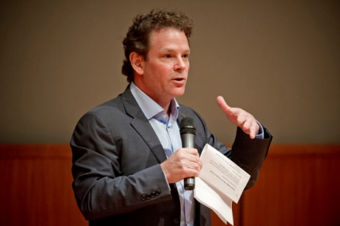
Origin
It was founded in 2013 by David Bornstein, Courtney E. Martin, and Tina Rosenberg.

Slide 23
Solutions Journalism
It’s central focus is solving social problems, using models and insight from experts. Checklist
Does the story explain the causes of a social problem?
Does the story present an associated response to that problem?
Does the story get into the problem solving and how-to details of implementation?

Slide 24
Solutions Journalism
Is the problem-solving process central to the narrative
Does the story present evidence of results linked to the response?
Does the story explain the limitations of the response?
Does the story convey an insight or teachable lesson?
Does the story avoid reading like a puff piece?: Solutions journalism is expressly not about advocating for particular models, organizations, and ideas. Journalists pursuing solutions stories are bringing their discernment to explore ideas and methods, not to advance an agenda or make people feel good.

Slide 25
Solutions Journalism
Does the story draw on sources who have a ground-level understanding, not just 30,000-foot expertise?
Does the story give greater attention to the response than to a leader/innovator/do-gooder?
It’s not a complaint; hero worship; favour for a friend; think tank; a afterthought attempt to write an answer which was not an element of the story

Slide 26

7 Steps to Writing a Solutions-based story

Slide 27

1. Identify a social problem
1. Identifying social problems that require solutions. E.g How to solve late-coming to schools

Slide 28
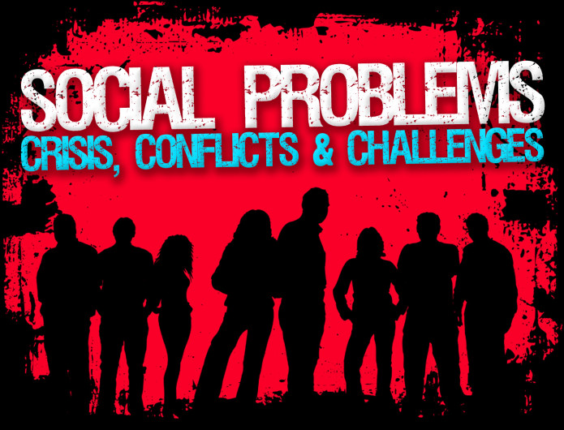
2. How does it affect the people?
Anecdotes, interviews, observations, and other ways of proving that it is a social problem

Slide 29

3. Gather relevant data
Look for data to support the level of seriousness of problems. Government, CSOs, academia, etc. Analytical reporting of the effects of the social problem on the people. Is it leading to closure of businesses? Is it cause health crisis? Is it creating conflicts in families?

Slide 30

4. Identify efforts already made to solve the problem
Identify efforts made by various actors to solve the problem: those involved in dealing with it. Find out how they have failed in solving the problem. You don’t just criticize, but acknowledge efforts.

Slide 31

5. Who has ever solved a similar problem?
Who has solved the problem? Find out how. Most times there are peoples who have solved the problem in the country or outside the country. To what extent did they do it, and under what climate?

Slide 32

6. Talk to Experts
Talk to experts in the sector to find out other approaches to solving the problem

Slide 33

7. State the way forward
A solutions story is emphatic about what next steps must be taken by who and how, in order to get rid of the social problem. You don’t just present the diverse views and leave a jigsaw to the reader to solve.

Slide 34
Investigative or Solutions?
Investigative
Expose wrong doers
Accountability
In-depth
Multiples sources
Multiple Evidence
Data, data, data
Solutions
Identify social problem
State the gravity of it
Generating heat
Look for models
Look for experts
Prescribe the way forward

